Slide 1
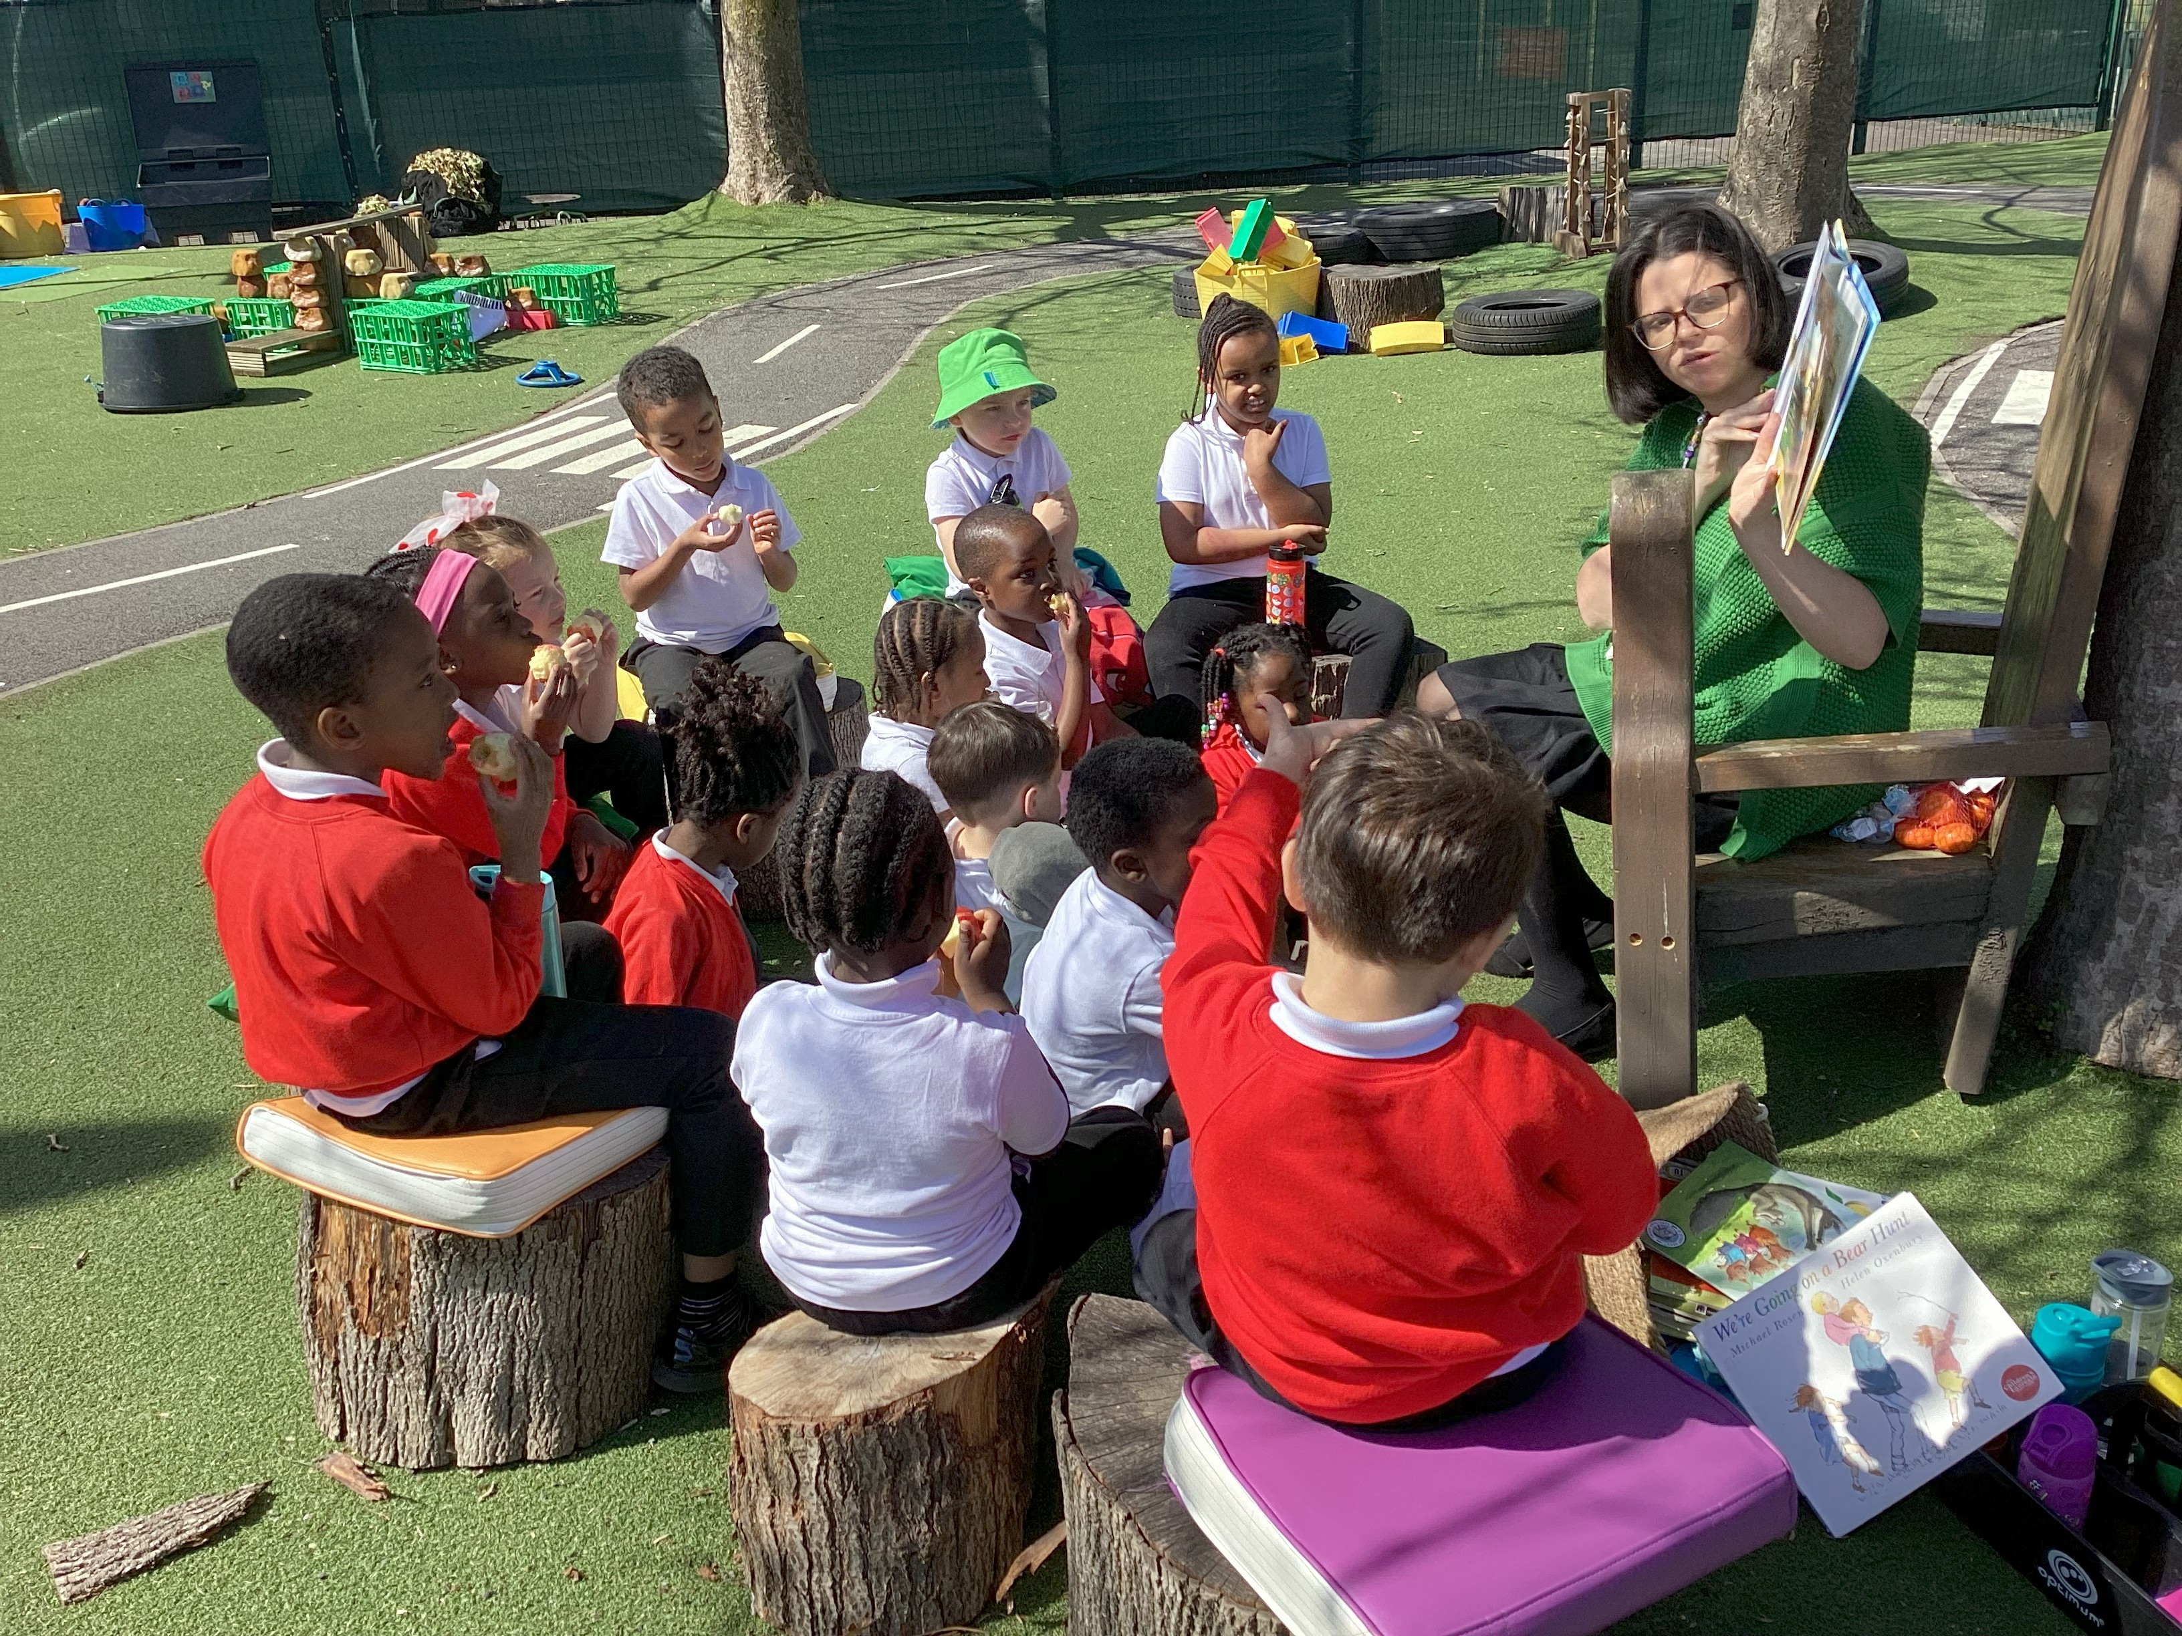
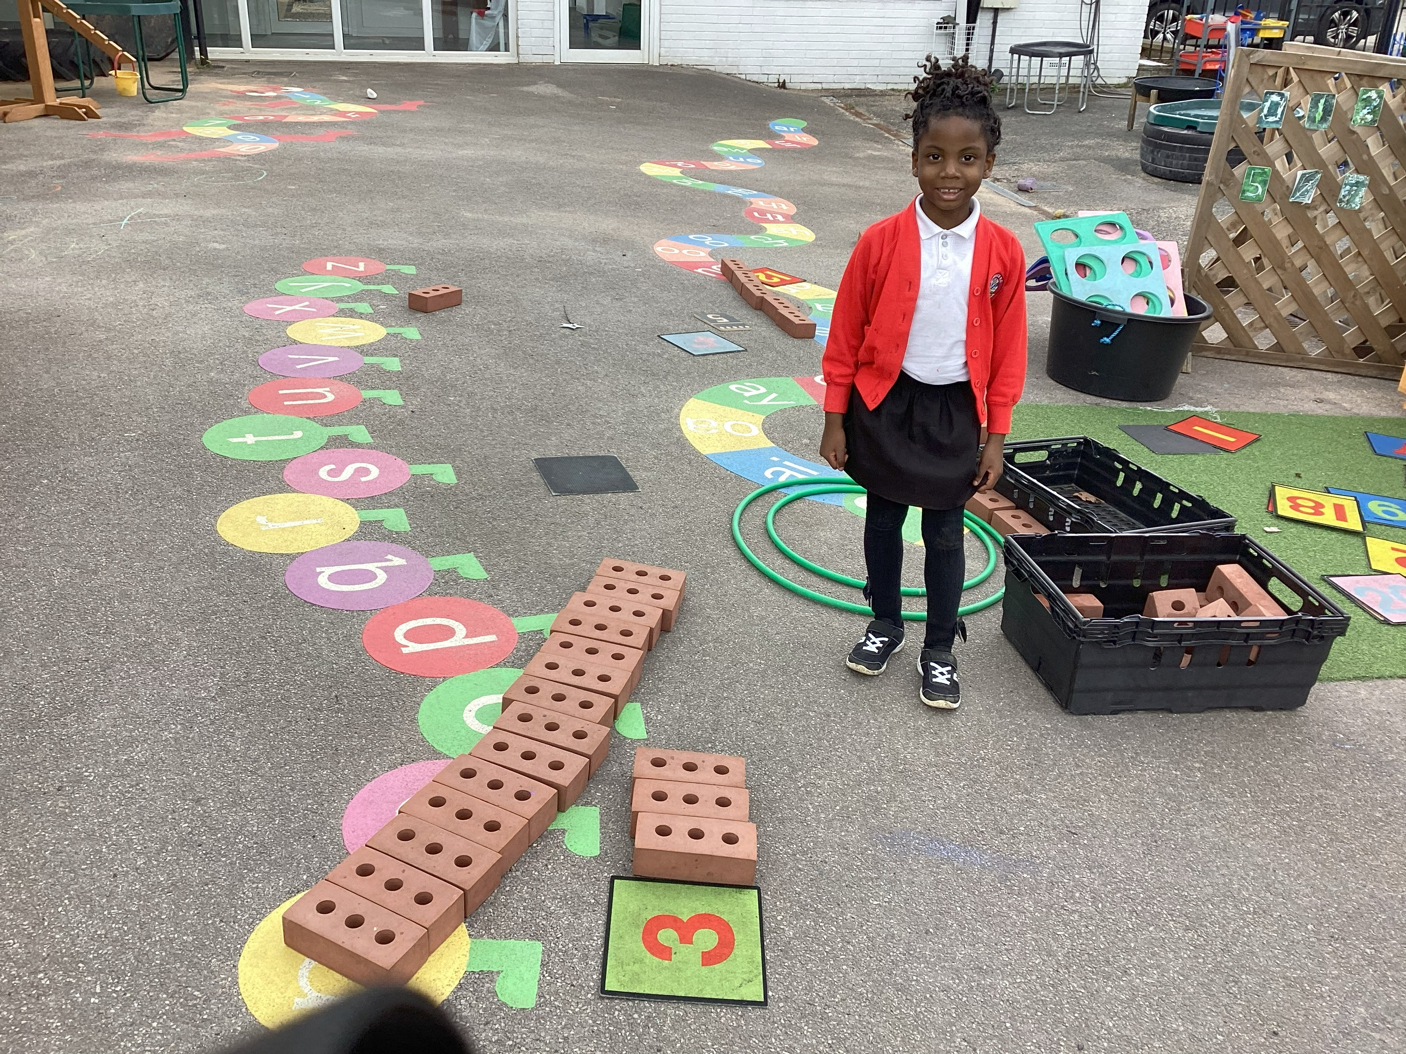
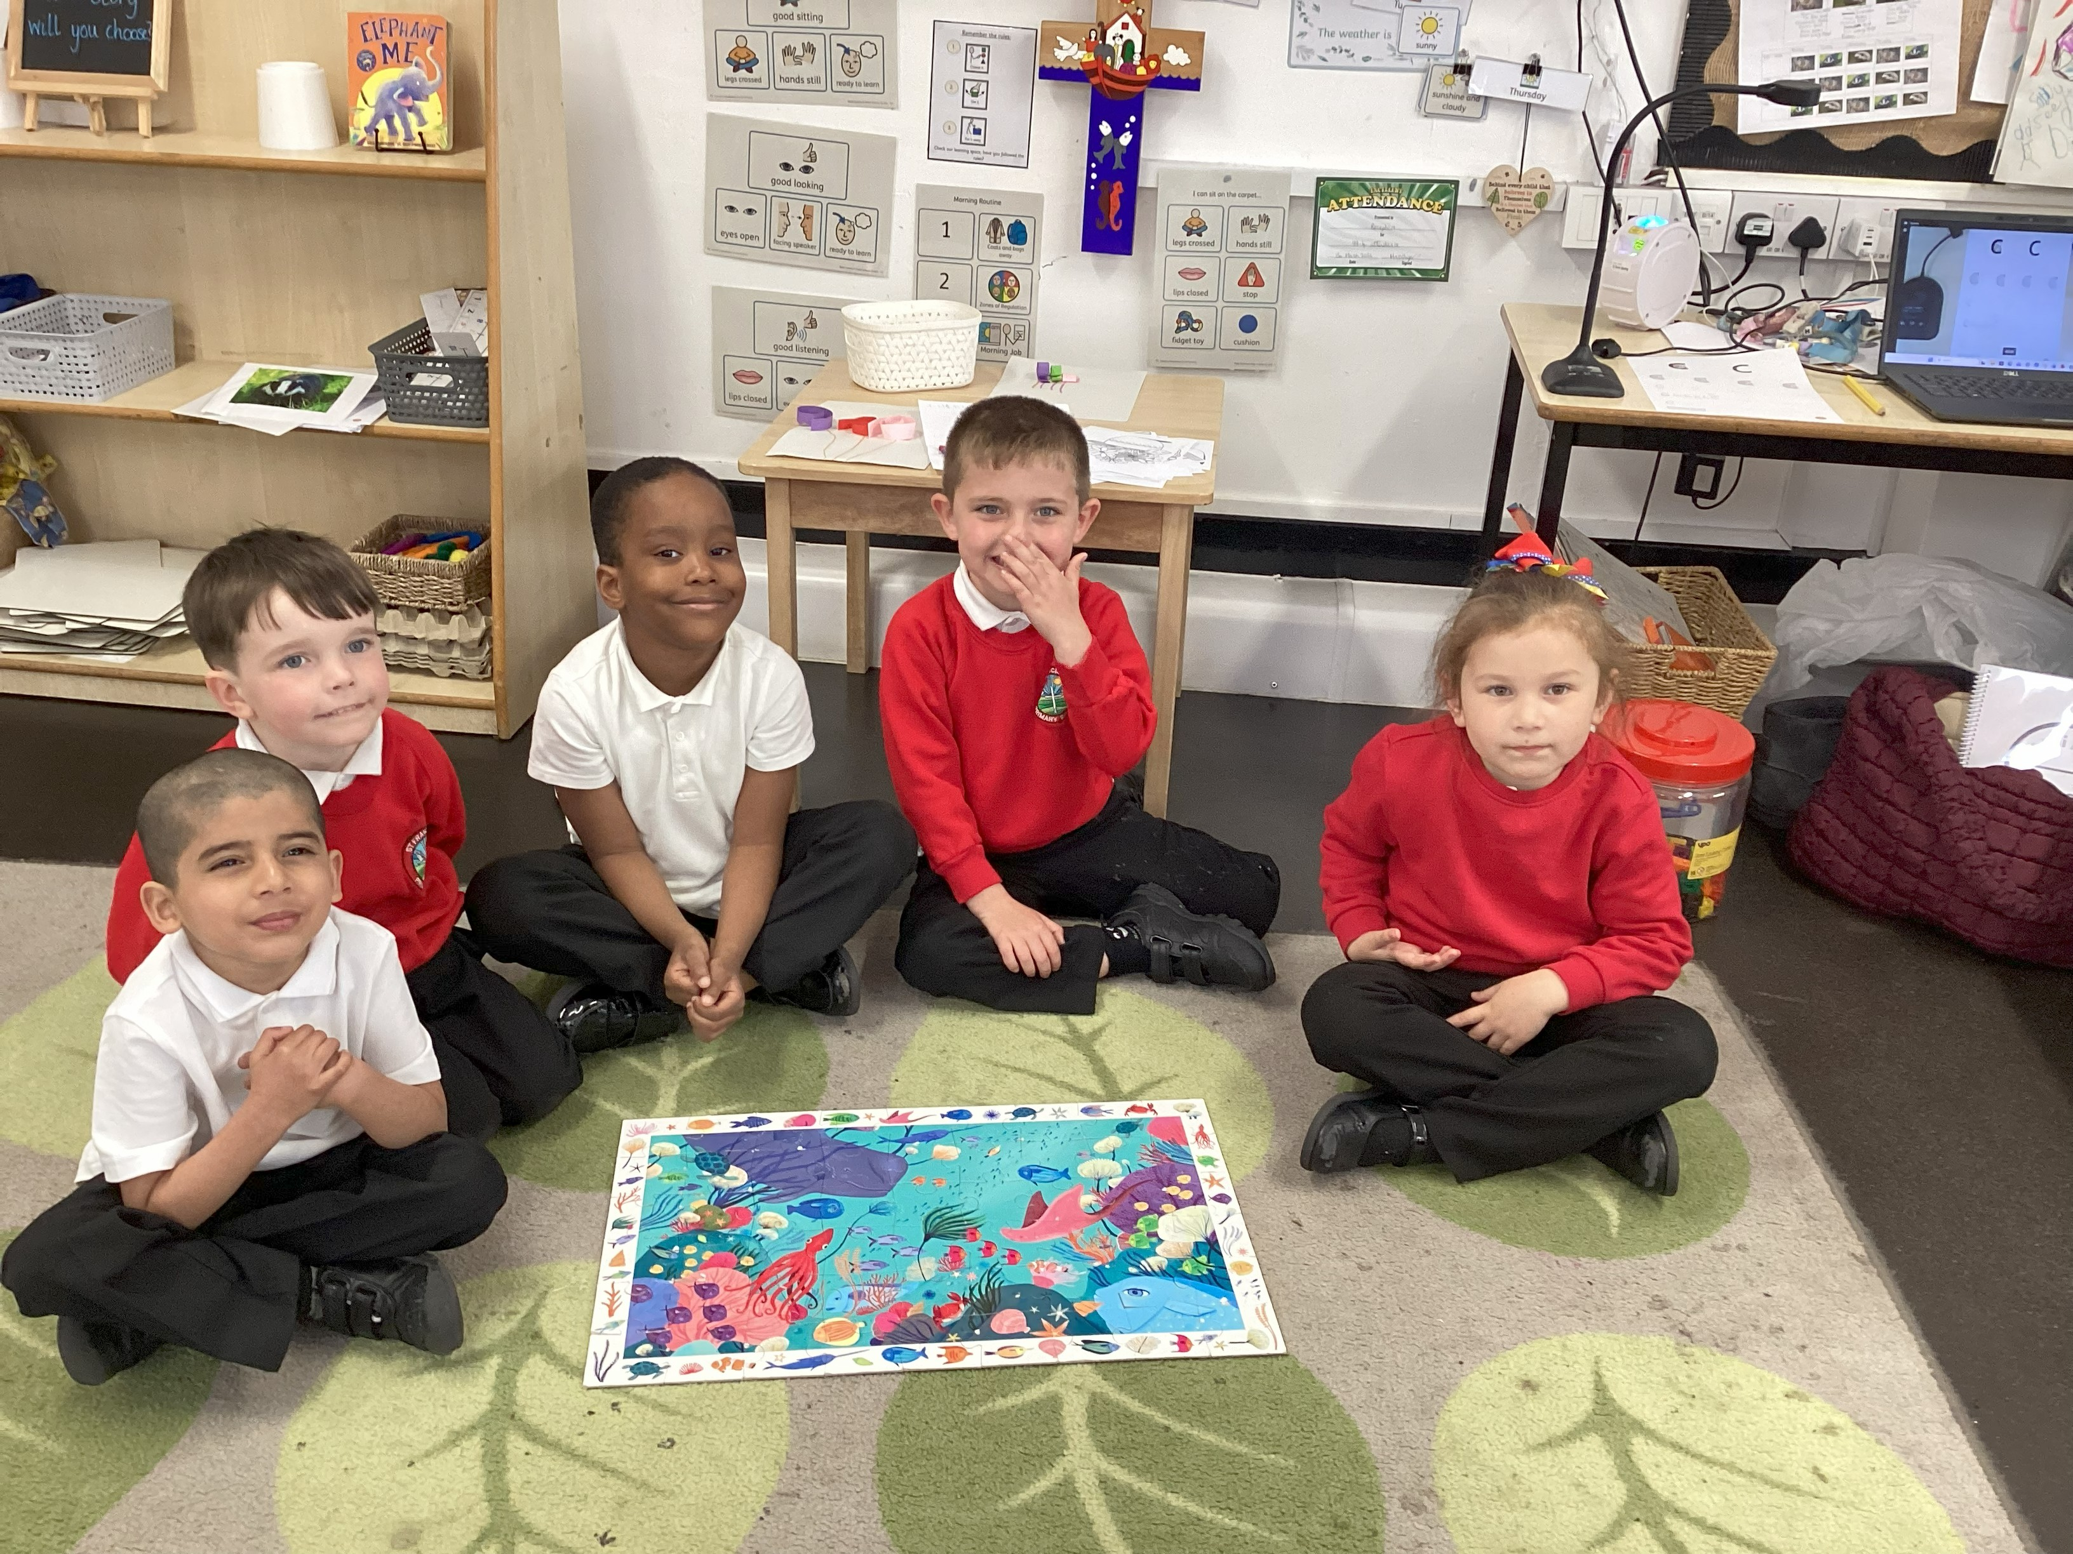
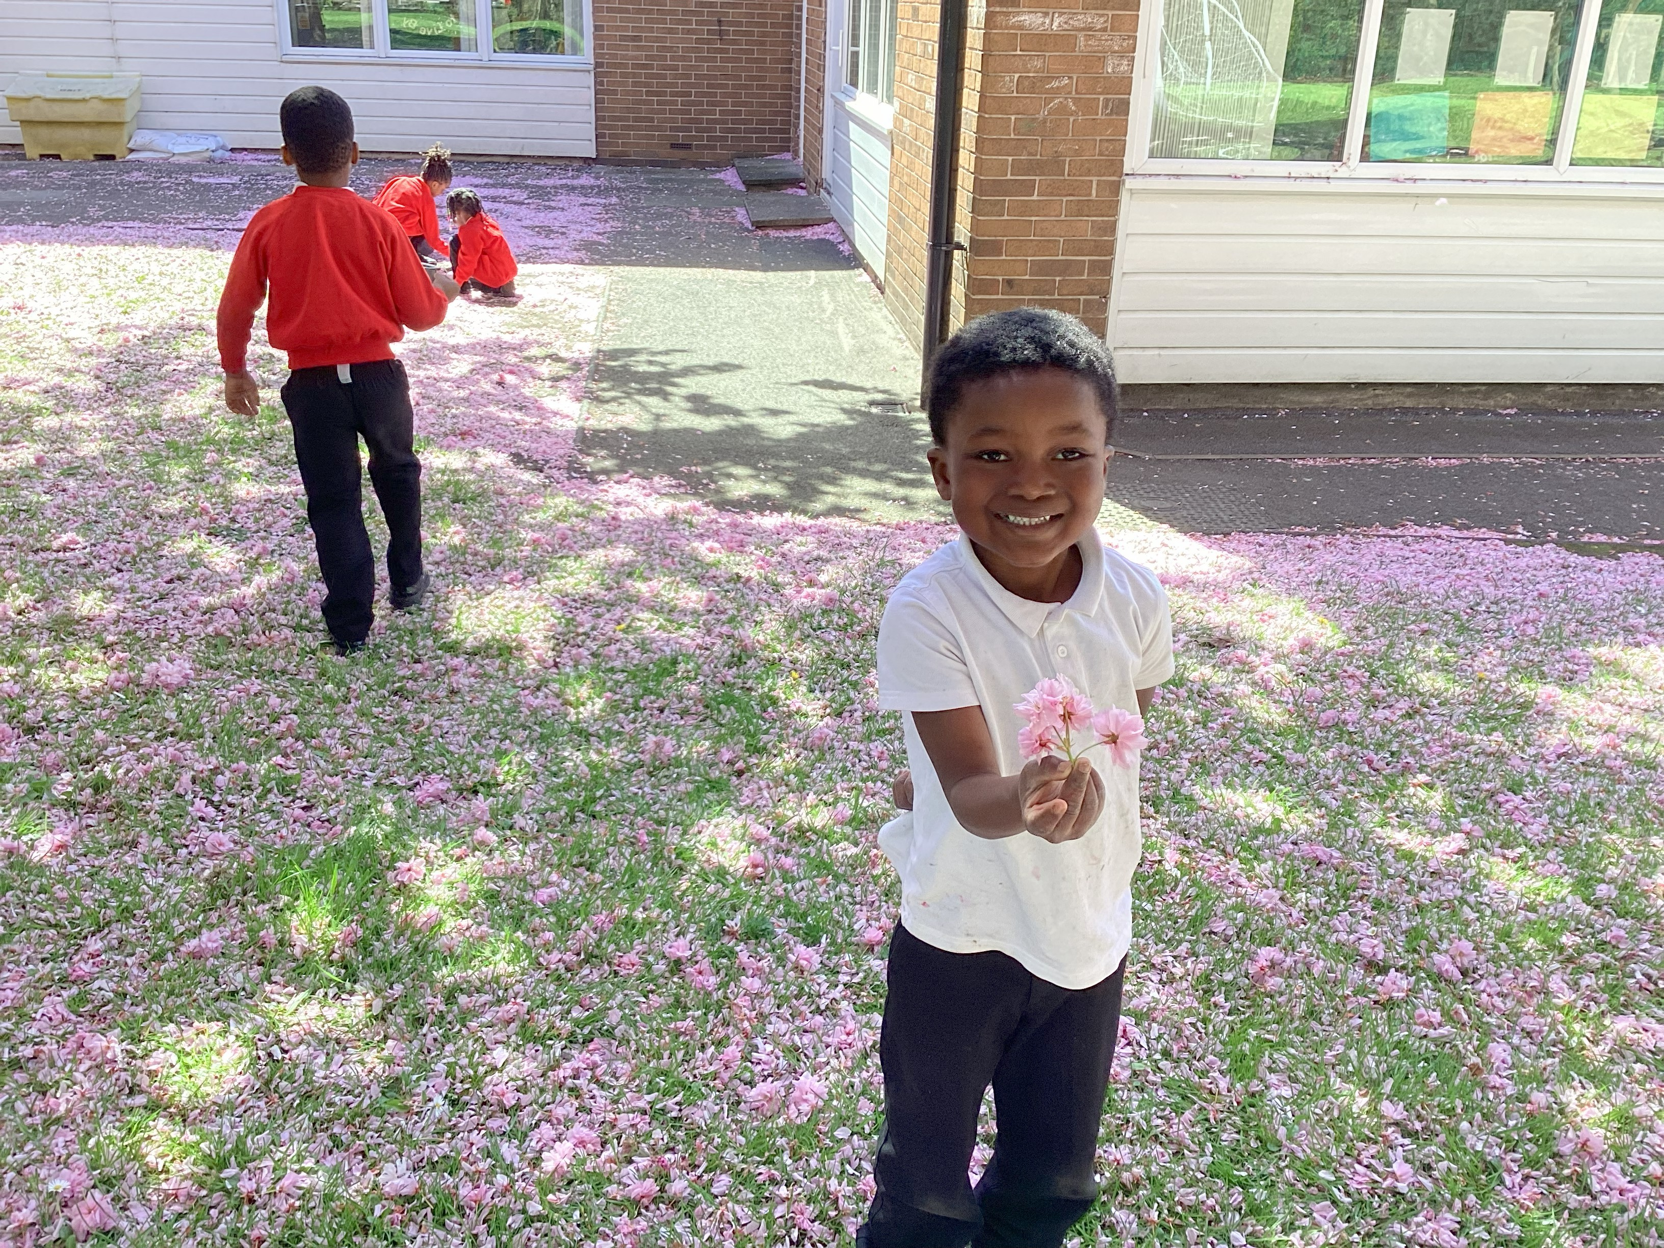

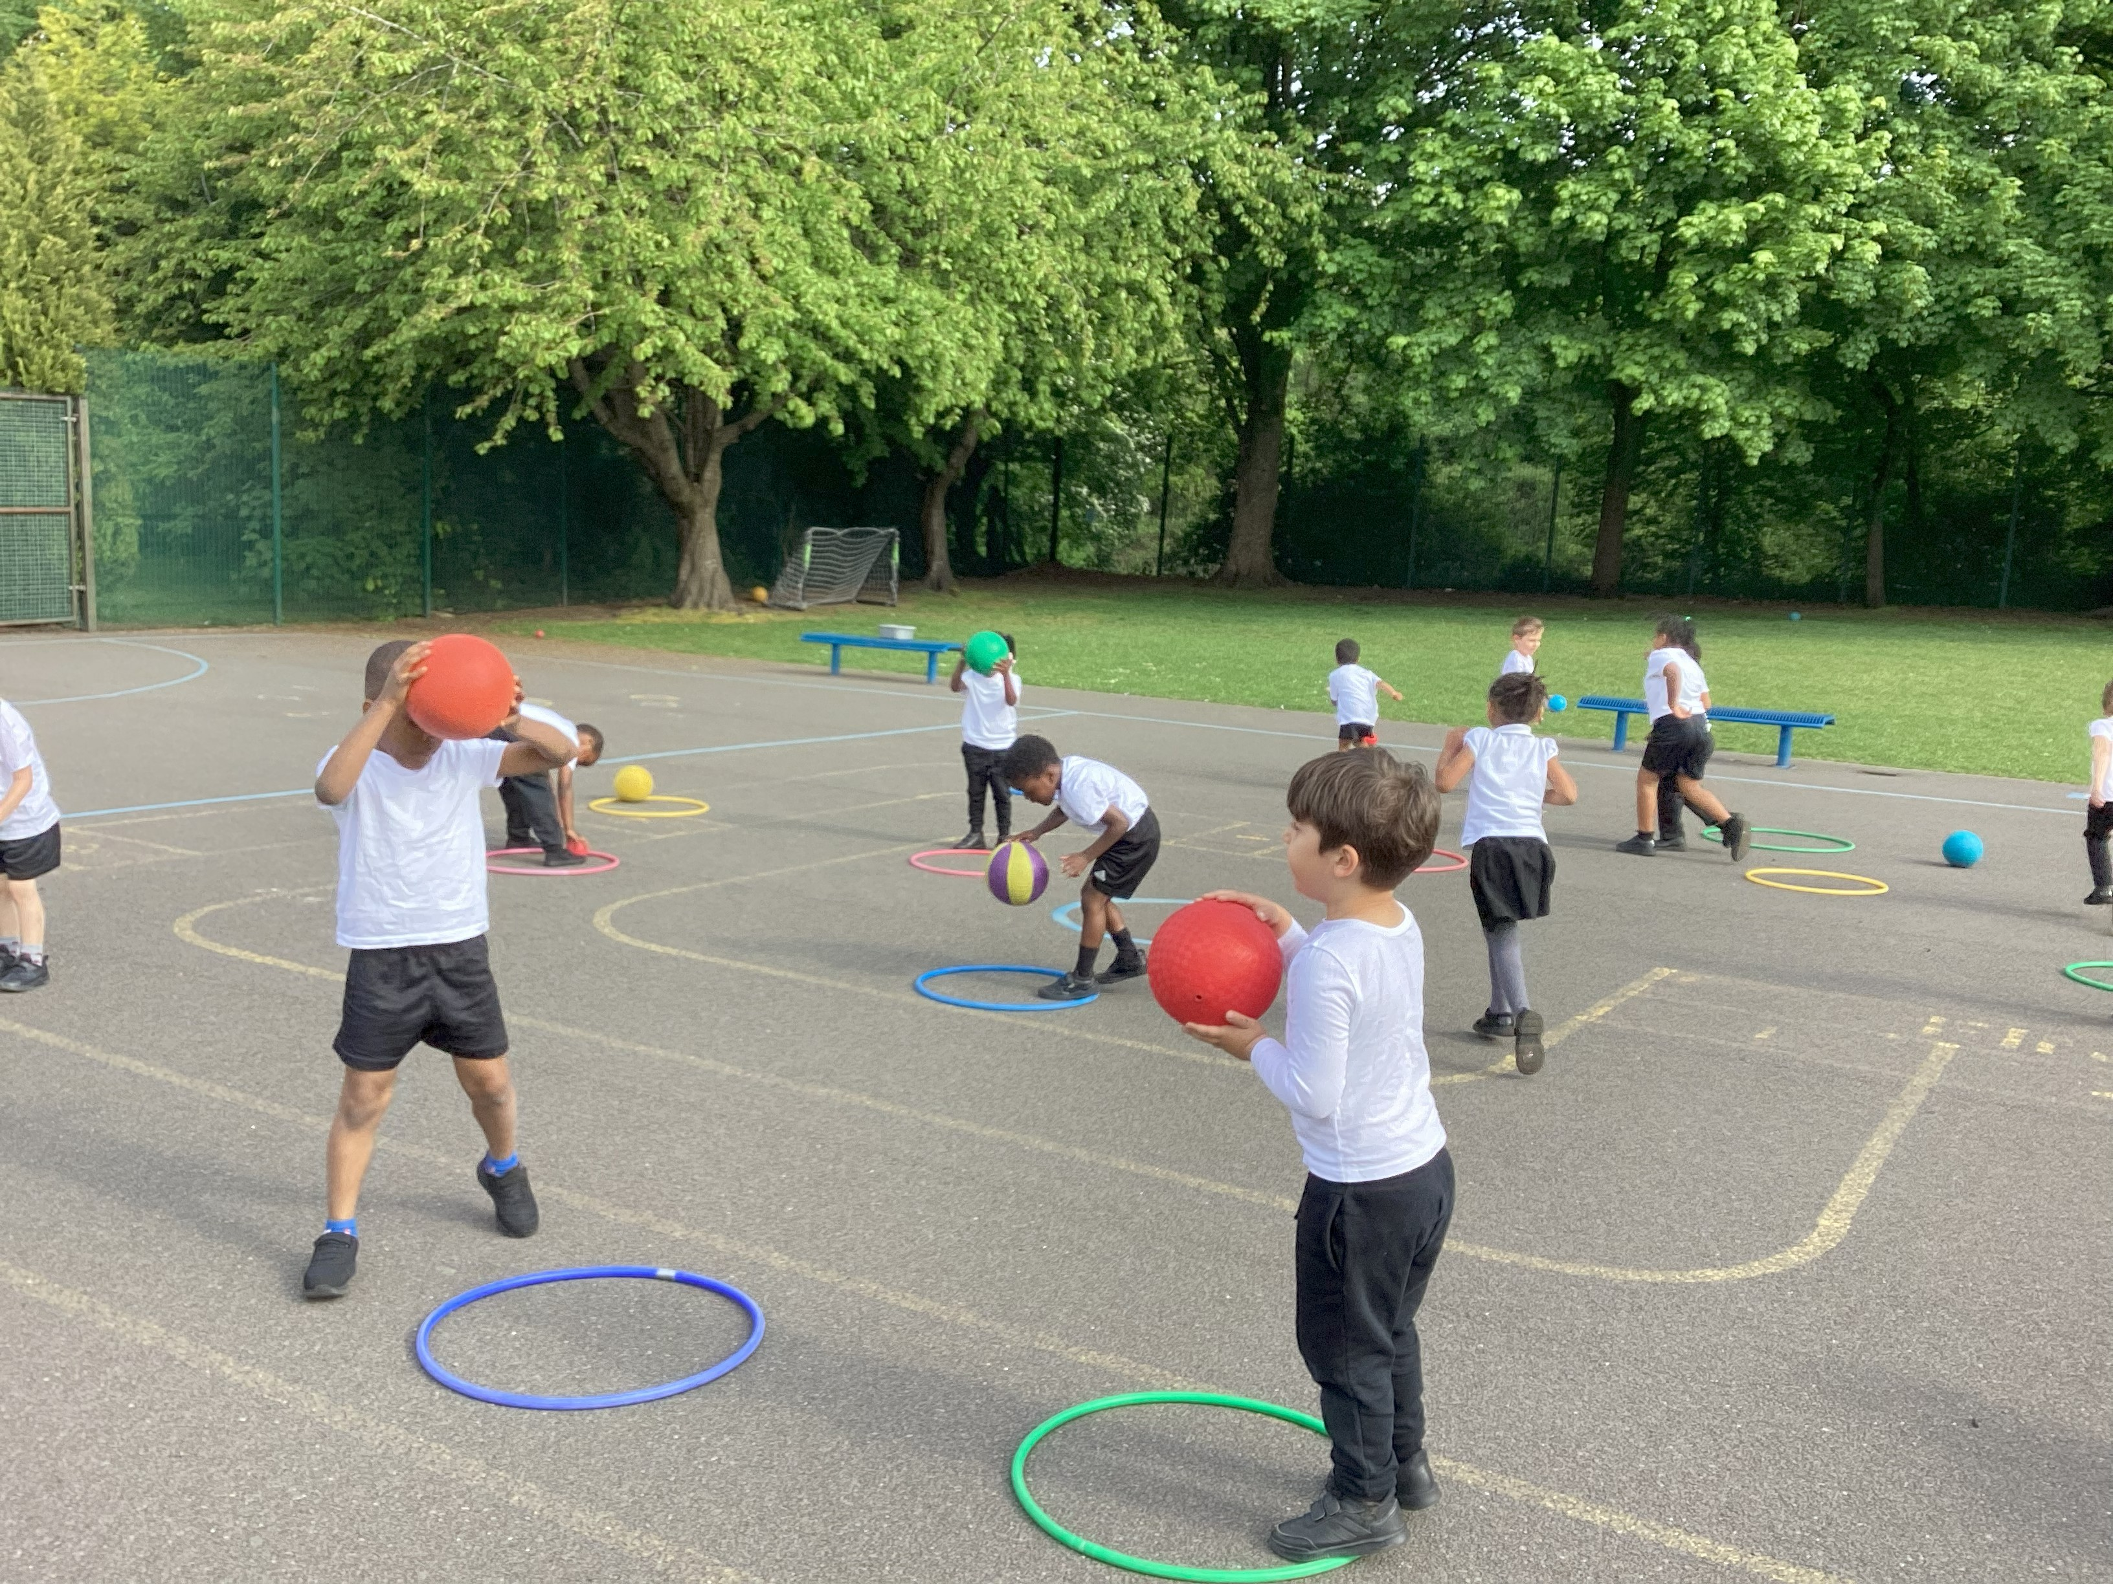
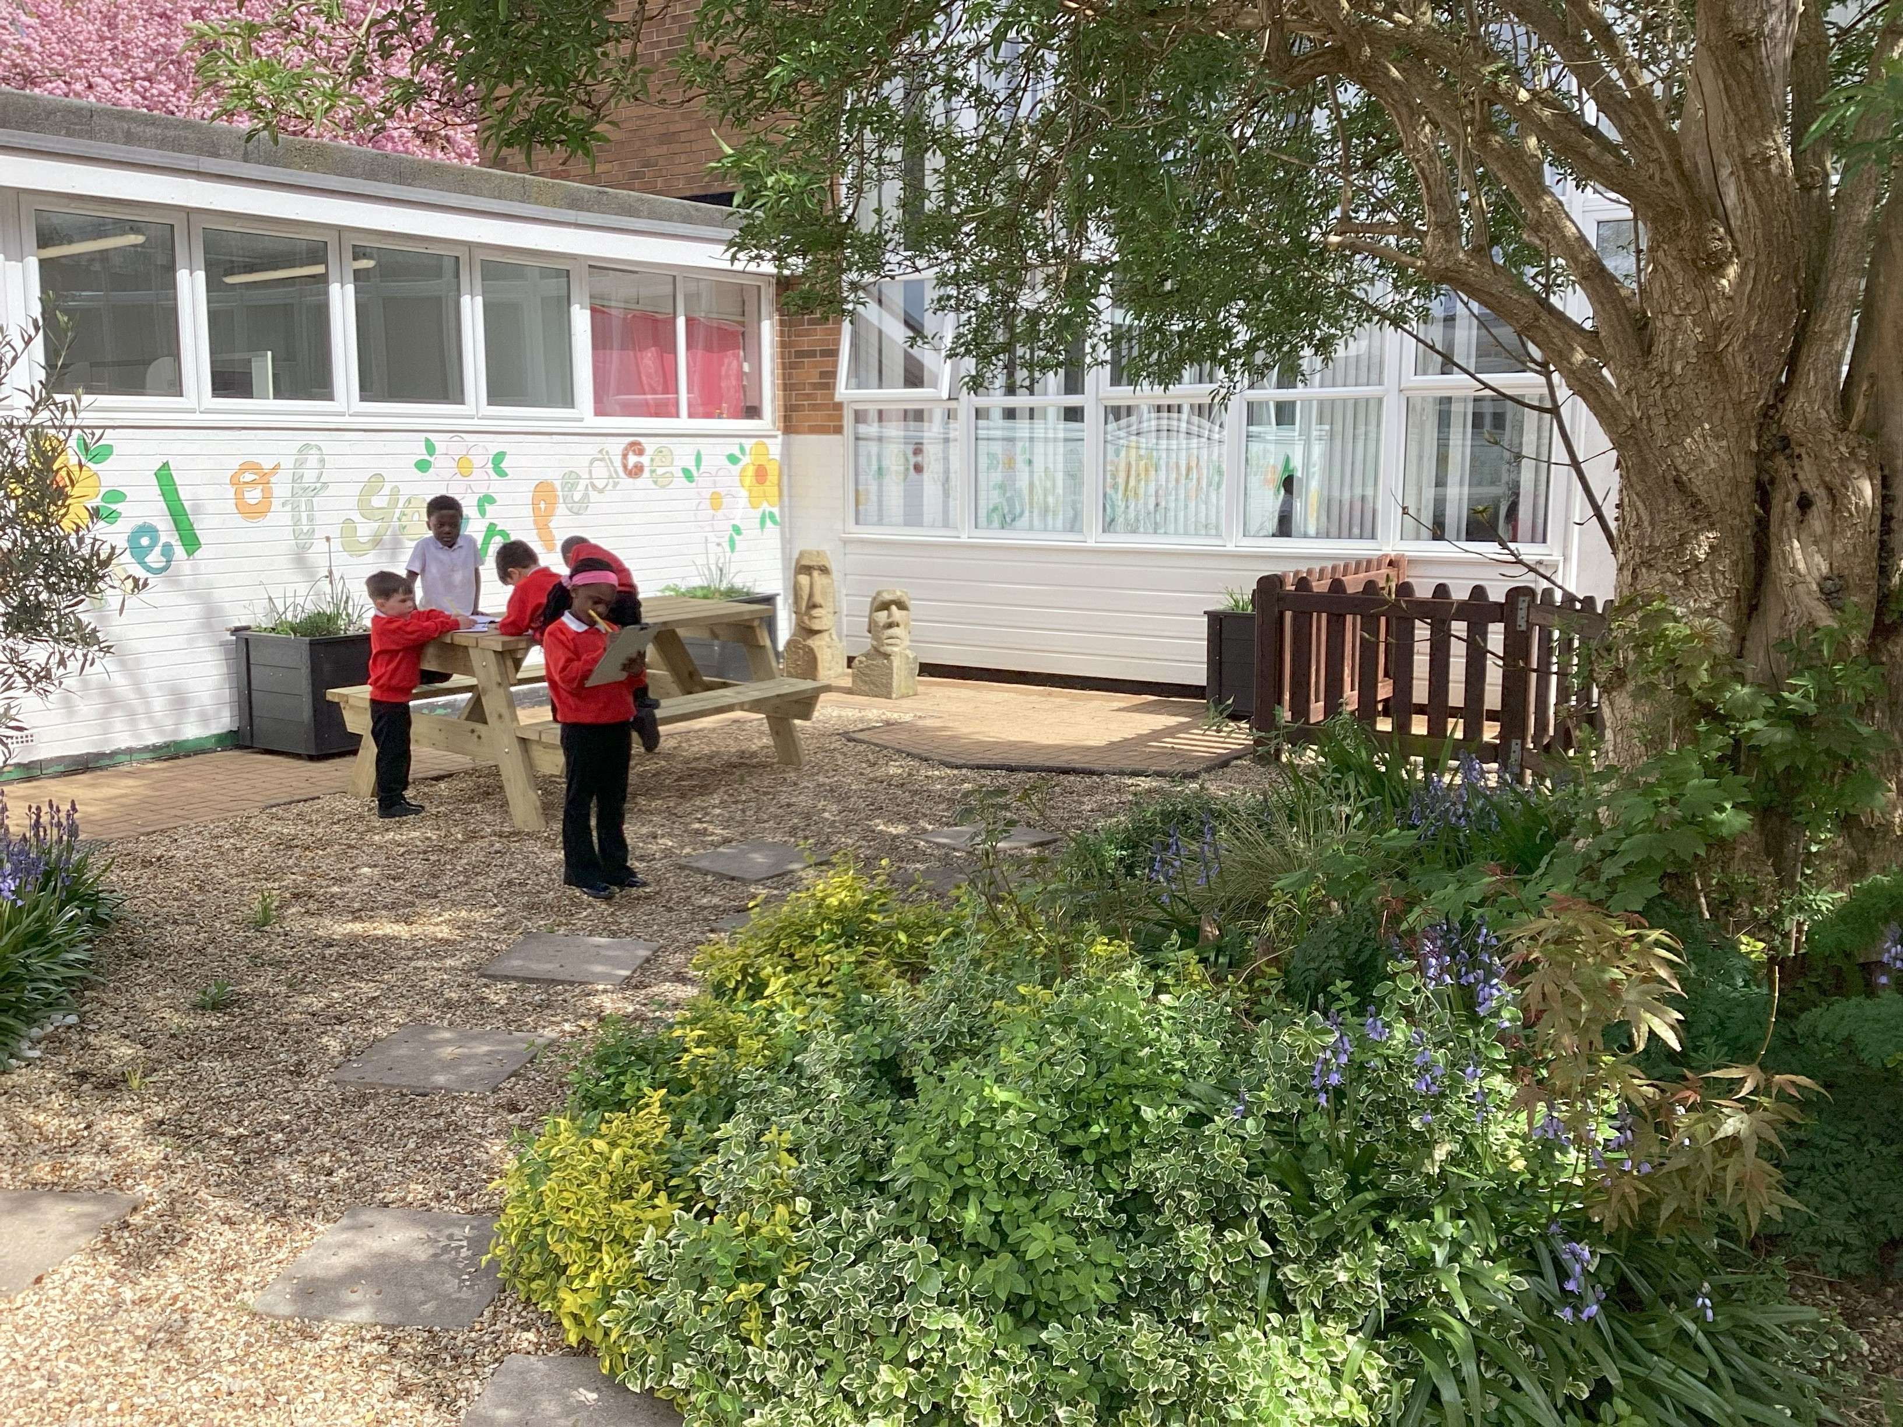
Information
for
EYFS Parents
2026-27

Slide 2

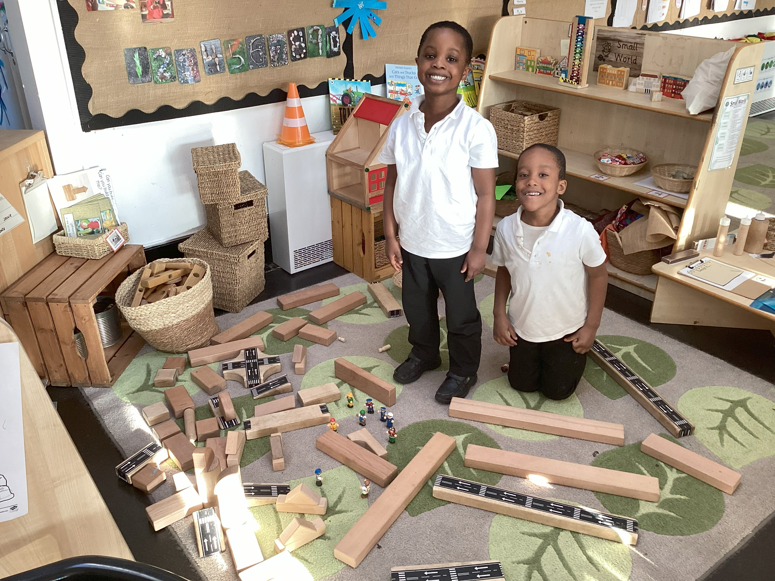
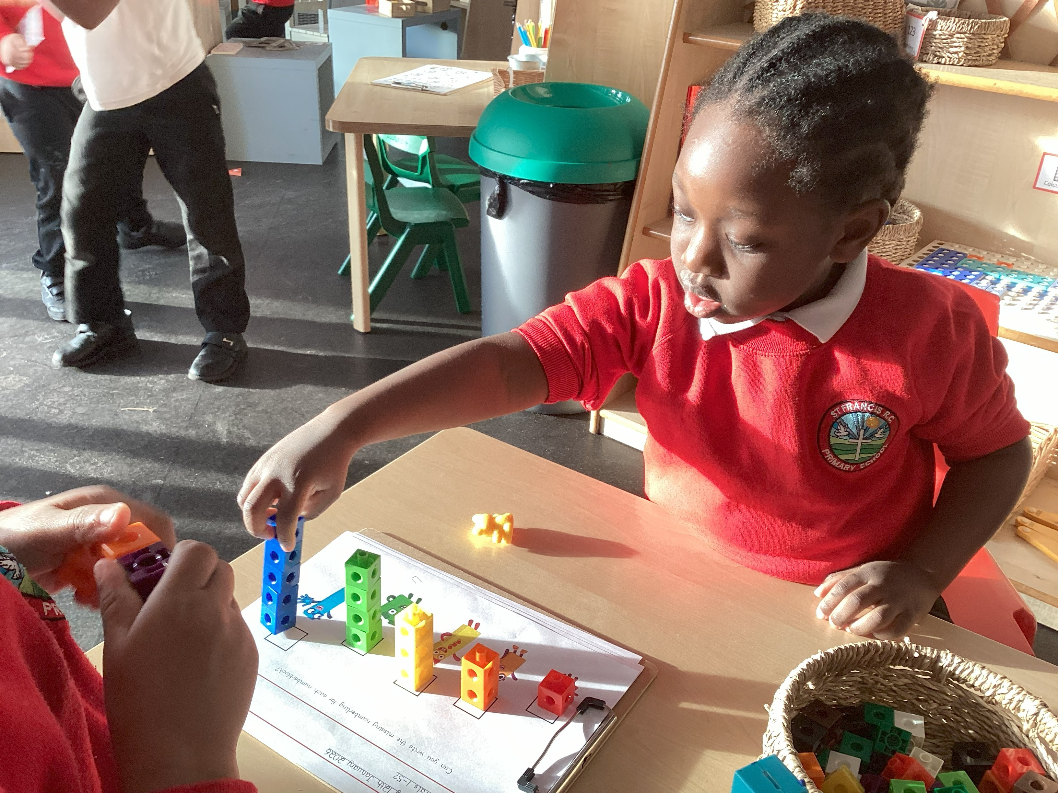
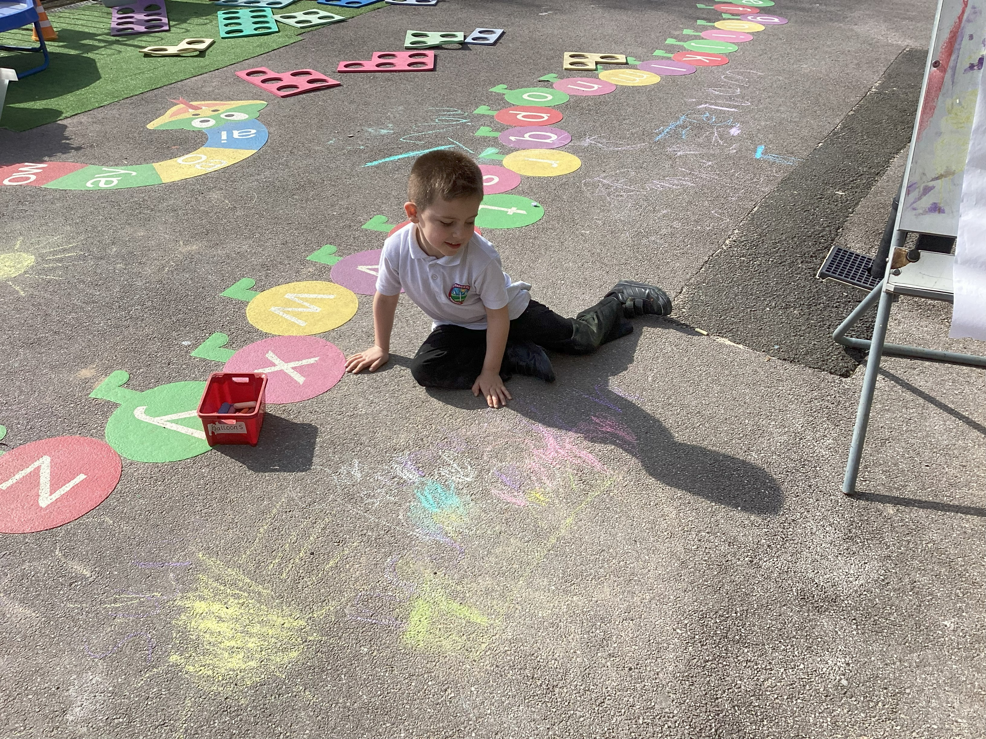
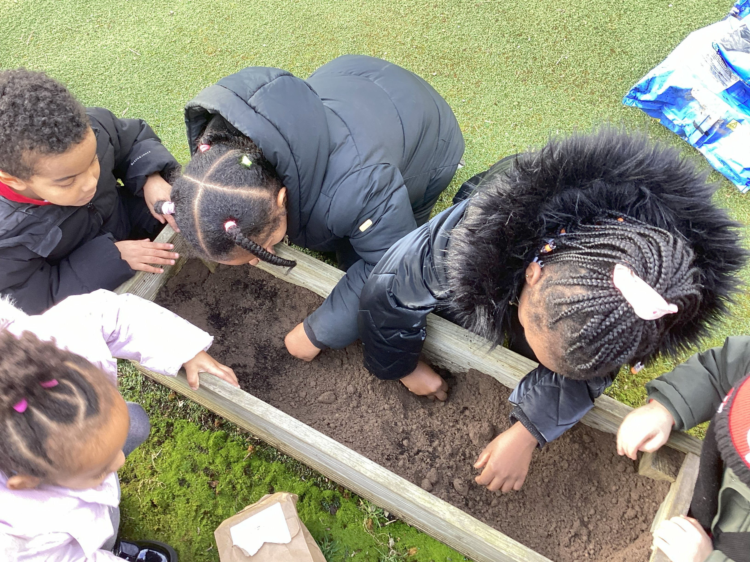
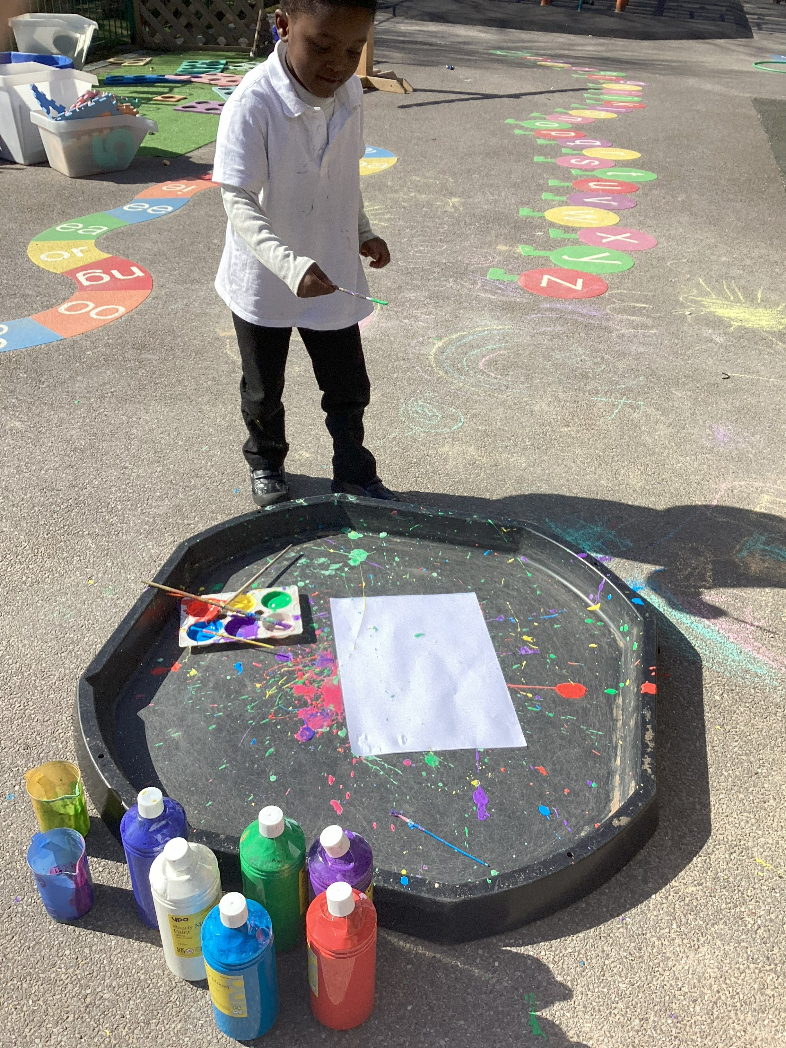
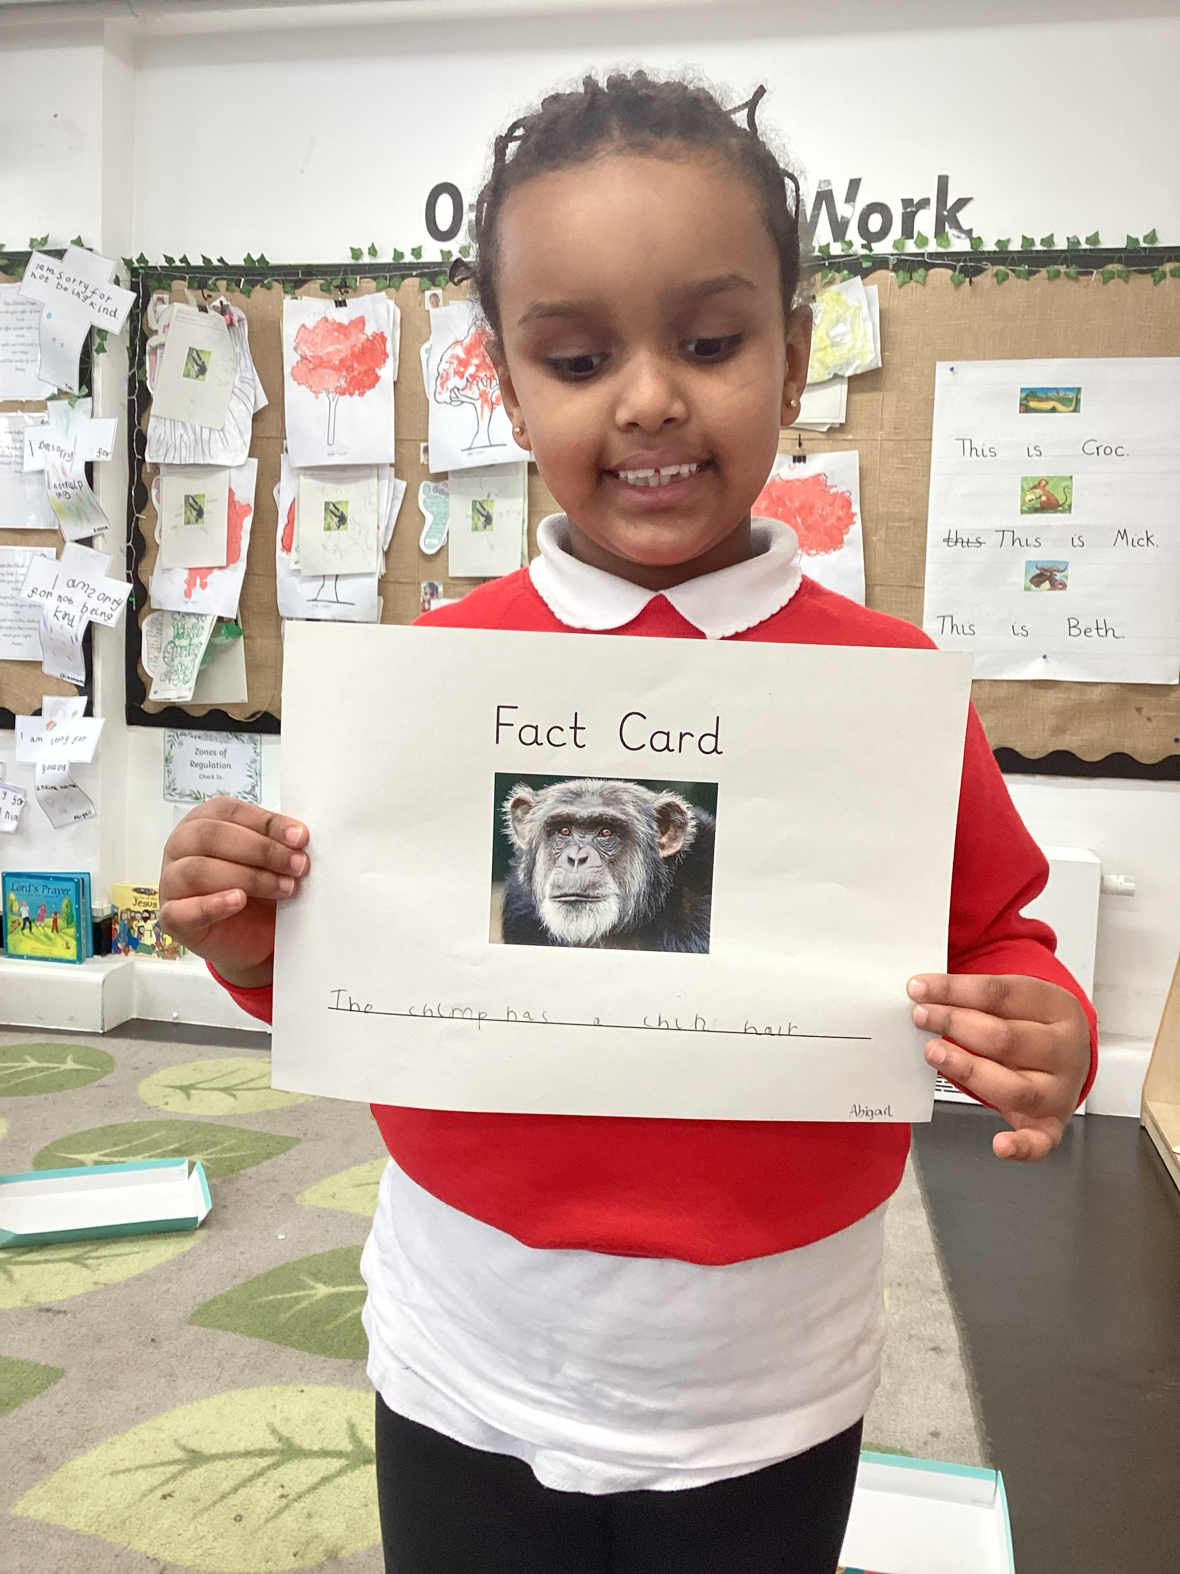
Welcome to
St Francis is in our reach
We believe that with God everything is within our reach’
Notes:
Behaviour panel to show each picture and explain what each means.
Respect
Persevere
Collaborate
Persevere
Explain that each half term they can work towards achieving the badges associated to each value. Give respect as an example.
Ask what they think they should be?

Slide 3
Today’s Meeting
General information regarding starting Nursery and Reception in September
Chance to ask any questions
Feel happy & content about your child starting at St Francis in September

Slide 4
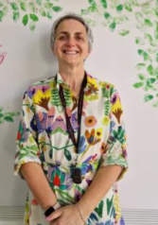
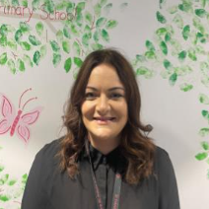
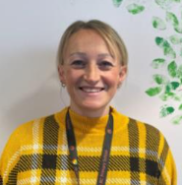
OUR TEAM…
Mrs O’Dwyer
Headteacher
Miss Deighan
Deputy Headteacher
Mrs Blake
EYFS/Phonics Lead

Slide 5
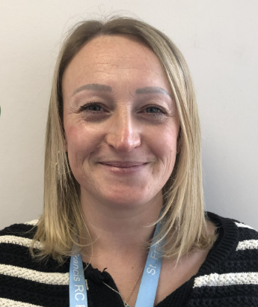
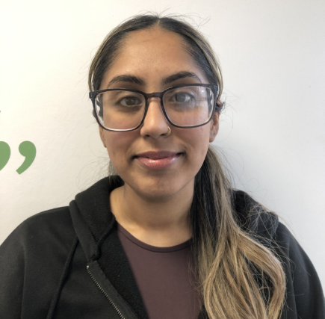
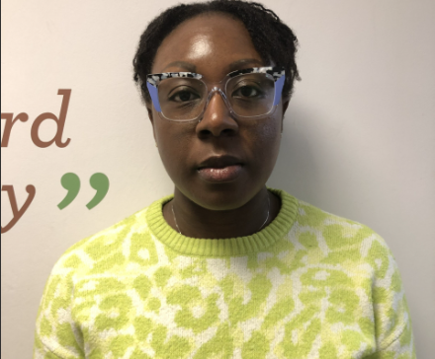
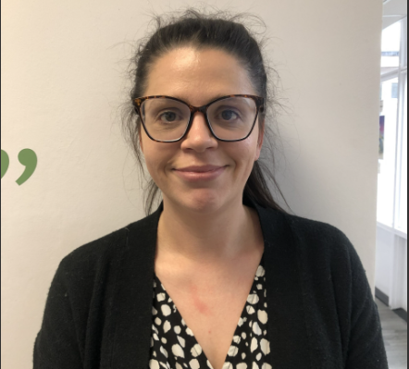
OUR TEAM…
Mrs Blake
Miss Azam
Mrs Opara
Mrs Mansell

Slide 6
Who to speak to if you have any questions or concerns…
Firstly: Class teacher or additional support adults
Secondly: EYFS Phase Lead – Mrs L Blake.
If there are further concerns, this will be escalated and discussed with the senior leadership team.

Slide 7


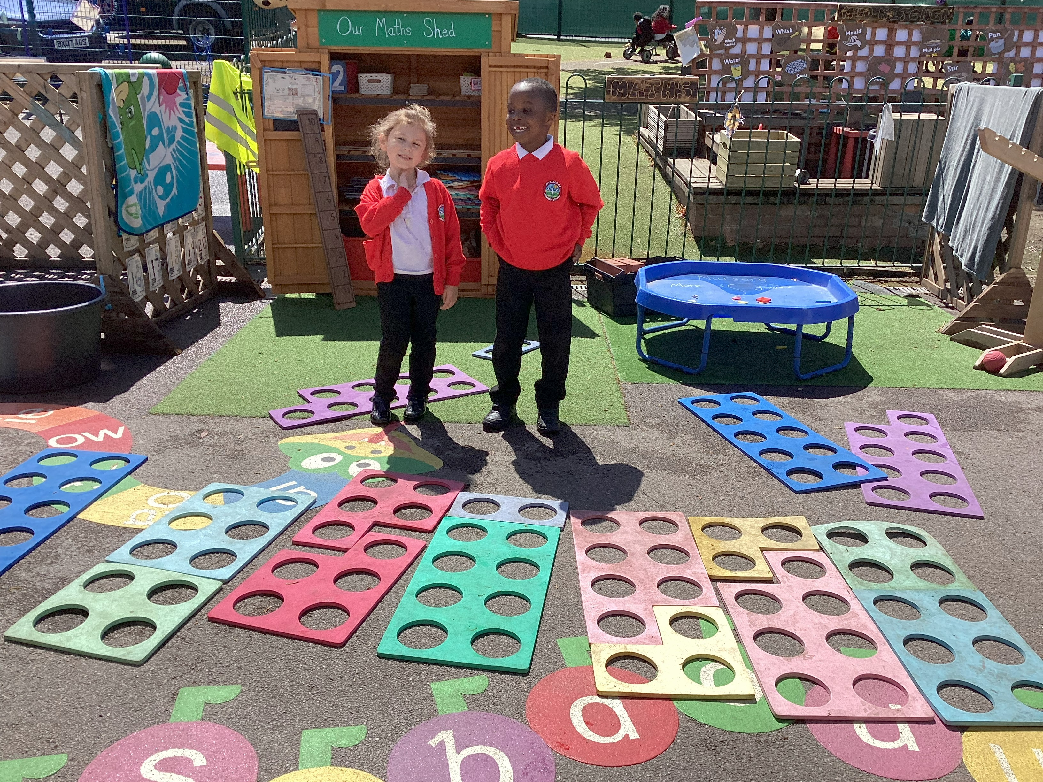
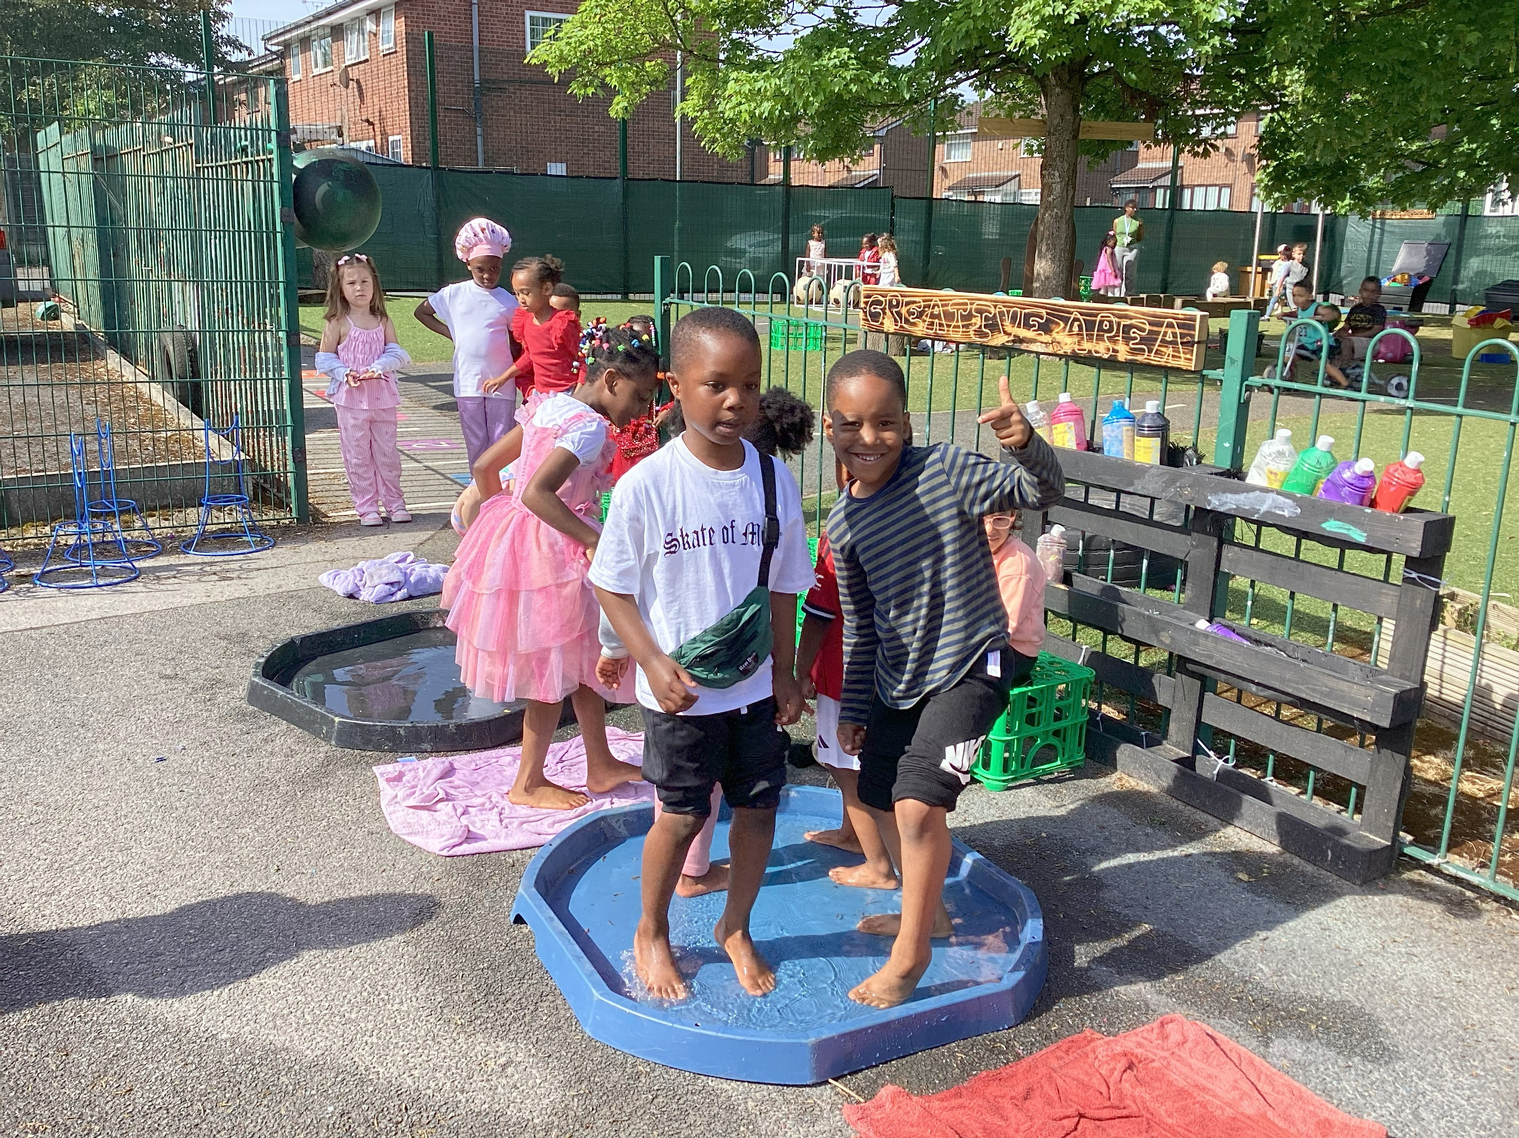
Our aims
Provide high quality education to all children
Create a happy, safe and secure learning environment.
Have positive relationships between staff, parents, children and the school community as a whole.

Slide 8

Structure of our EYFS
26 place Nursery
30 place Reception class
1 teacher / TA per class

Slide 9
Transition into St Francis
Transition morning Wednesday 1st July 9.00 - 11.00am
Children are invited in to spend some time with their teacher and classmates and playing in their classroom.
School starts Thursday 3rd September
In September, initially for new Nursery children there will be a part time settling in period to ensure that they feel comfortable and settled –please see timetable in your pack
Reception – full time from the first day back in September
Individual transition information can be discussed and staff are happy to support with this should you feel your child needs a longer transition.

Slide 10
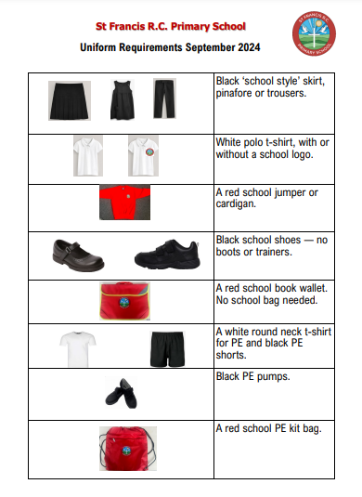
School Uniform
We require all children to wear our
St Francis Uniform – helps to
encourage pride in our appearance and
The sense of belonging to our school
Smart on the outside, smart on the inside
We ask that children do not wear trainers to
school and if children have their ears pierced
then only a small set of studs are permitted.
School uniform can be purchased from
KK sports at Gorton Market.

Slide 11
Routines
Doors open at 8.40am - Children can be dropped off at their classroom door where they will be met by their teacher.
Children will take part in activities and play throughout the day
Lunch 11.30 – 12.30pm
End of day is 3.20pm - Children are to be collected from their classroom door.

Slide 12
Snack and lunch time
Children in Early Years are eligible for free milk and fruit up to the term after they turn 5.
Following update guidance from the DfE we are actively promoting only water and milk within school. Please provide children with a water bottle and fresh drinking water each day.
Lunch time - school meals – See menu options
Nursery children currently - £2.40 per day
Reception children are eligible for 'Free school meals' under the government initiative.

Slide 13



Example lunch menu

Slide 14

Snack and lunch time
If your child would prefer a packed lunch, please look at the ‘Healthy lunch’ information in your pack for ideas.
Birthdays – we also request that if you are wanting to celebrate your child’s birthday rather than treats we ask for a story book that can be shared with the class.

Slide 15
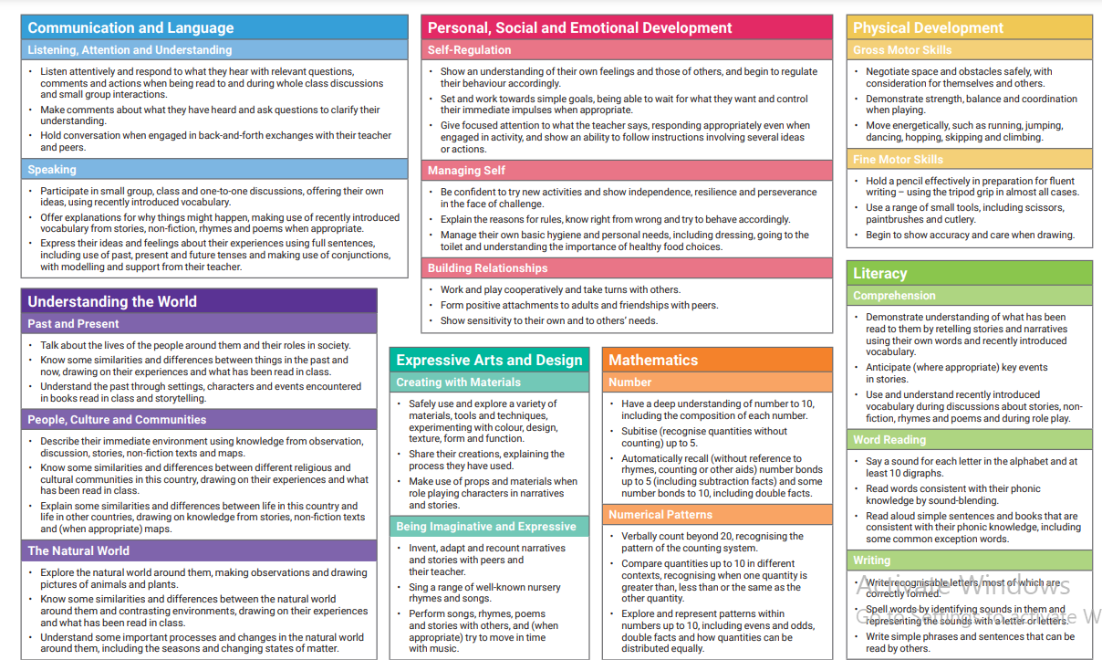
Early Years Curriculum
We are working towards achieving the Early Learning Goals in all 7 areas of the Early Years Curriculum;
Communication & Language
Personal, social, emotional development
Physical development
Literacy
Maths
Understanding the World
Expressive Arts & Design
The first 12 ELGs form the
‘Good Level of Development’
for Reception Children

Slide 16



Curriculum…
Phonics
- Little Wandle
Maths
Master the Curriculum – Nursery
Mastering Number - Reception
Topics
All About Me
Autumn/Woodland
Animals in cold countries
Animals in hot countries
Lifecycles
Journeys

Slide 17


Curriculum…
Teaching
- Targeted group times throughout the day to help us meet the curriculum expectations
Continuous Provision
- Indoor and Outdoor learning environments
- Carefully planned resources and opportunities to continue the learning in the ‘absence of an adult’
Enhancements
-Can be linked to topics, children’s interests or gaps in learning.

Slide 18
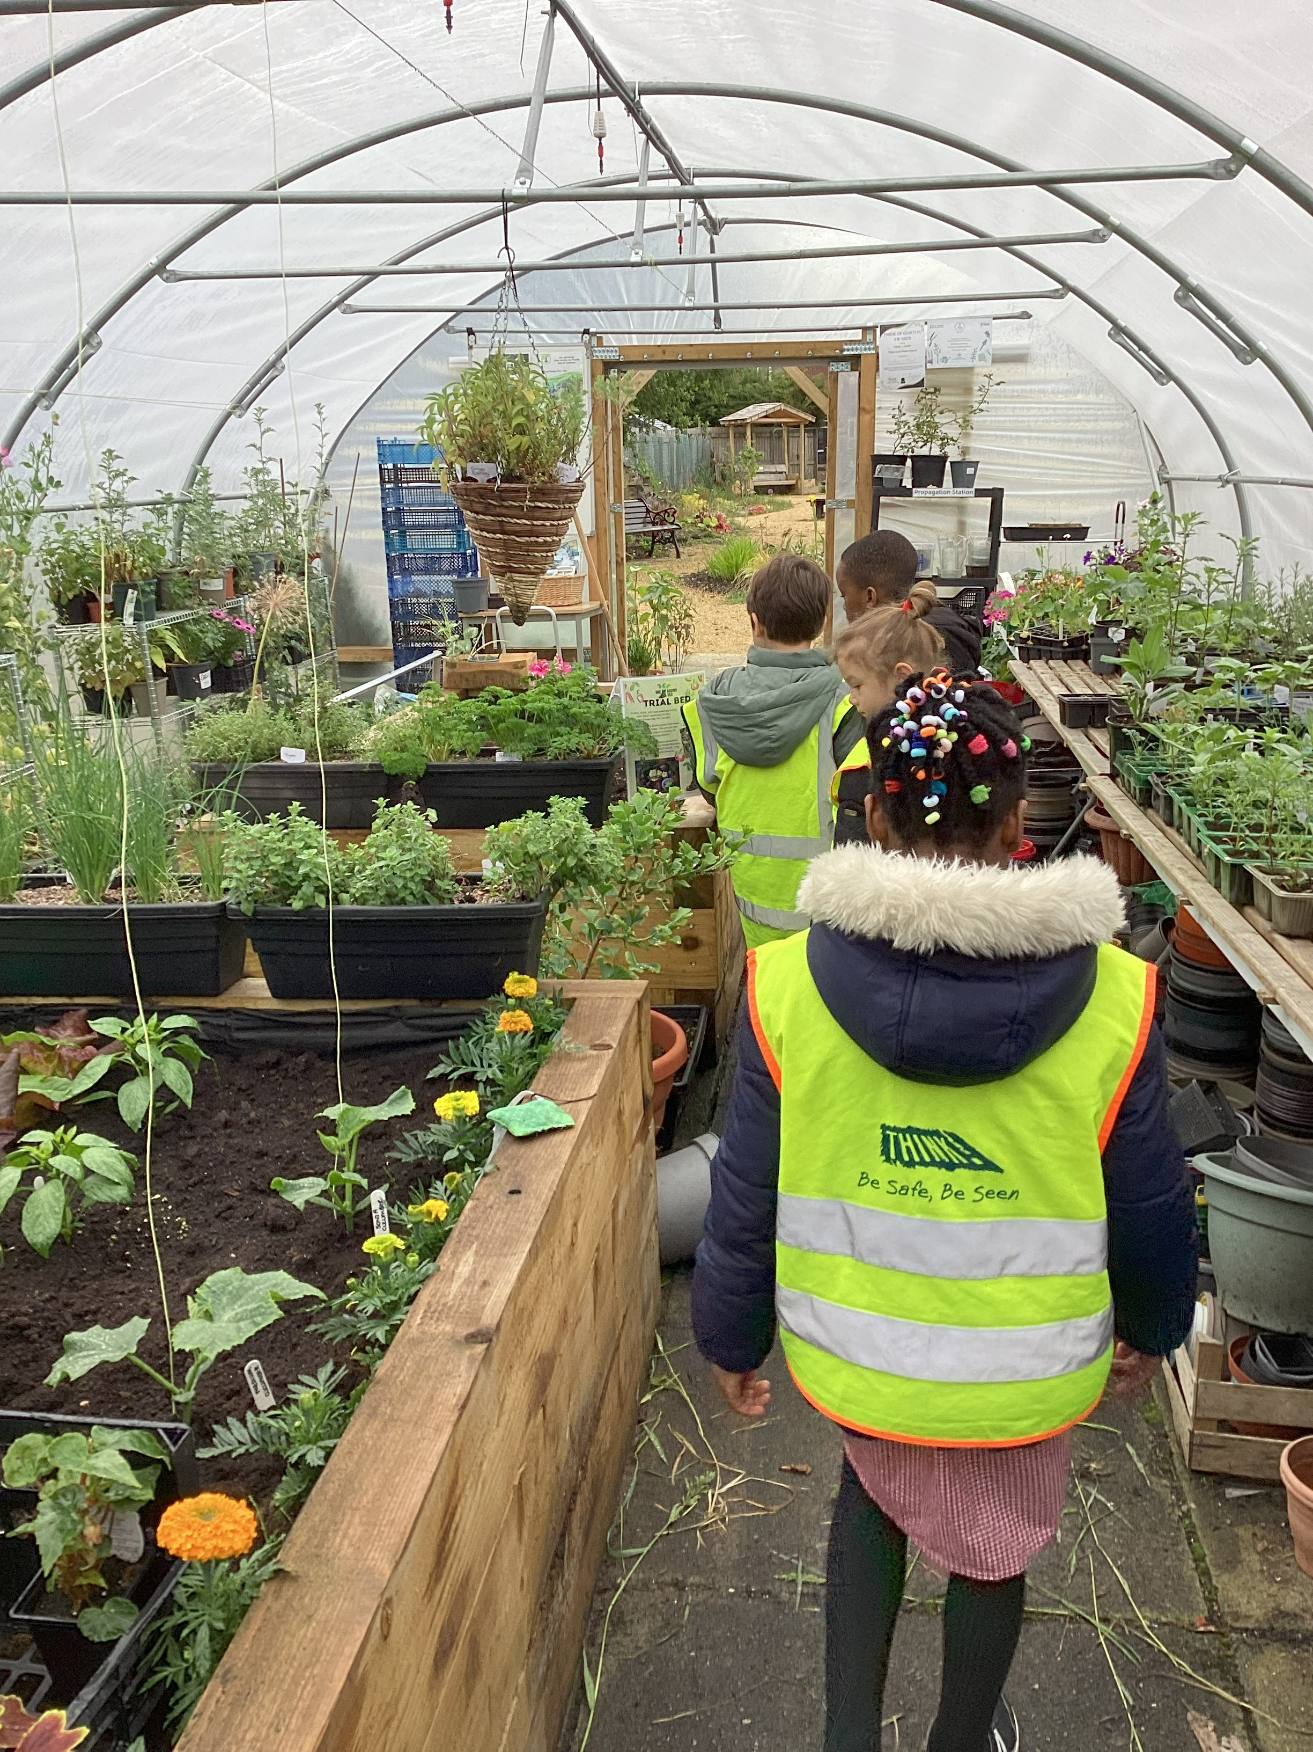
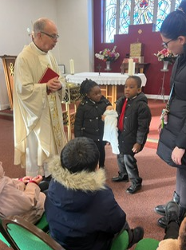

Educational experiences…
Outdoor learning opportunities
Visit to Church/from Father Kevin
Visit to museum/farm/zoo
Visitors to school
Themed celebrations – World Nursery Rhyme Week, World Book Day, Nativity performance, class assemblies
Stay and Play sessions for parents

Slide 19
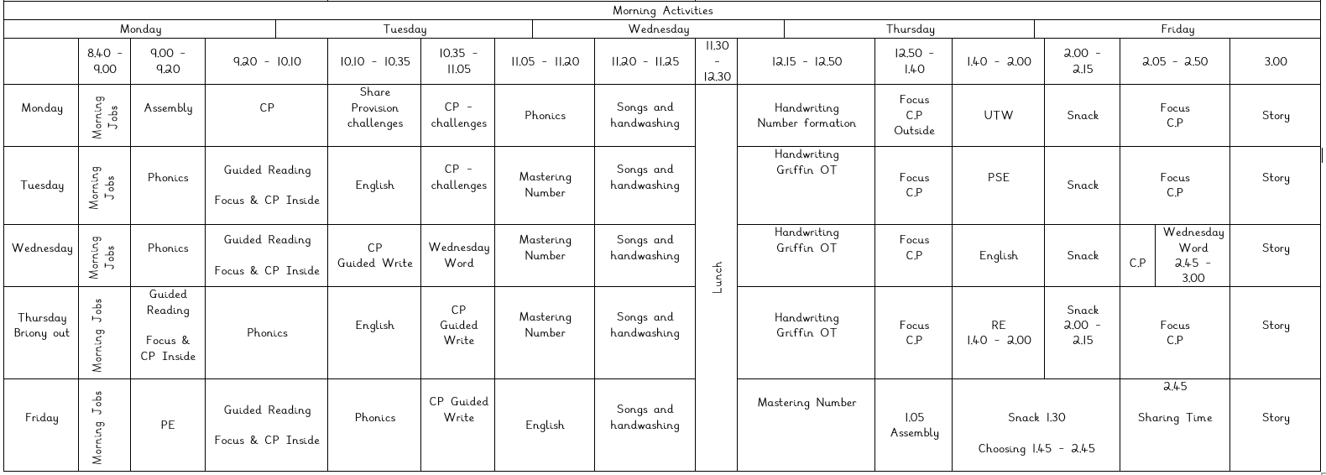
Weekly Timetable…

Slide 20
ASSESSMENTS
Baseline assessments – to support us with next steps – where will we start our teaching?
Reception Baseline is statutory
Children will be assessed regularly to track progress
If children are at risk of falling behind, support will be put in place to help them ‘keep up’ – parental support is key
Daily assessments
Phonics assessments
Termly assessments

Slide 21



Ways to support your child
Talk to children about their day, ask them to tell you about what they have been learning
Homework – allow children to have a go, but encourage them to take pride in their work – not scribbling through the pages in their books.
Help children to practise their sounds and their reading each day
We learn to read so that
we can read to learn.
Little Wandle Phonics – Parent workshop in the Autumn term
Keep an eye on Instagram and Seesaw for photographs
Getting Ready – ‘Every little helps’ socks, shoes, coats, toilet training, wiping bottoms, seeing names, reading, drawing, songs, talking, counting etc.

Slide 22
Attendance and punctuality…
It is vital that children are in school on time every day to settle them into their school day, create a structured routine and accumulate no lost learning
Classroom doors open at 8:40 and the gate is closed at 8.50am. Any child arriving after 8:50 will be marked as late and will need to enter the school building via the main school office.
If you know your child is going to be absent, you must contact the school office before 8.40am to inform us as to the reason why.
We ask that parents and carers ensure all appointments are made outside of school hours. Evidence for these will be required for this absence to be authorised. If there is no evidence available then this absence will not be authorised. We understand that some appointments cannot be moved so please ensure medical evidence is provided.
Only exceptional circumstances warrant a leave of absence. To request a leave of absence: please apply in writing to the headteacher.

Slide 23
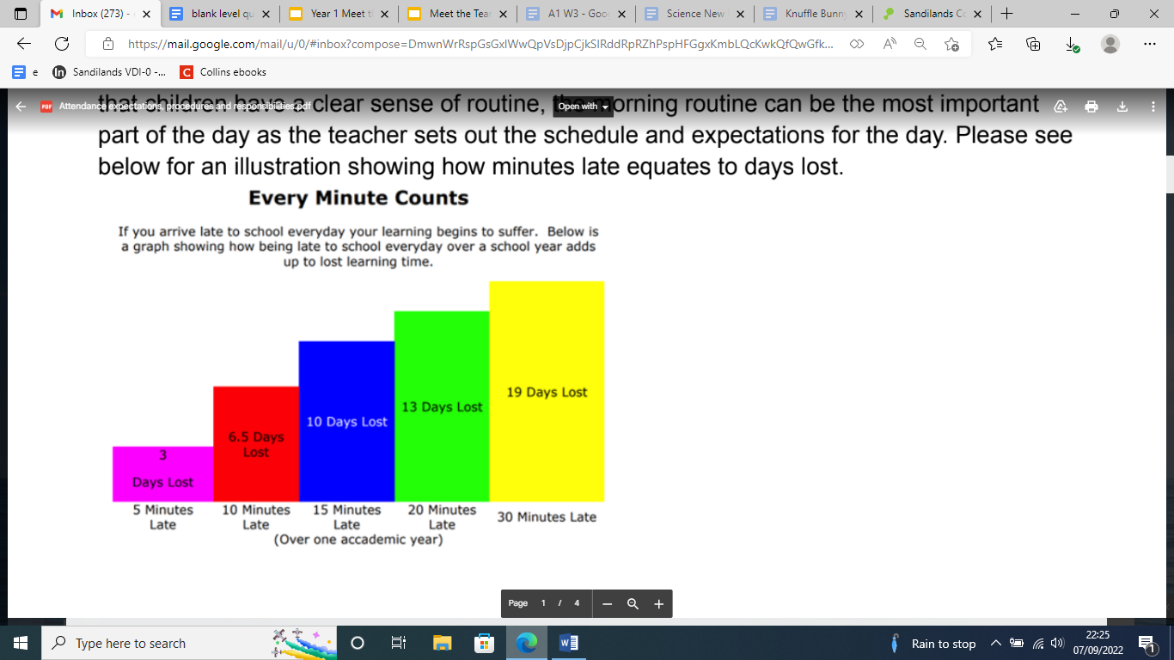
Attendance and punctuality…

Slide 24
Expectations
Children to arrive at school on time each day
Children to come to school in correct school uniform – See handouts in your pack
Children to have their school bag every day.
Reception
Reading record/reading book in school every day. Please read with your child each day.
Any homework completed
PE kits to be brought in to school and left on children’s pegs for the half term.

Slide 25
Essential !!!!!
NAMED ITEMS – please name everything !!!!
Spare clothes – in case of accidents
Wellies/waterproofs for Wet days – spare pair to leave on pegs
No jewellery – one pair of small stud earrings
Hat and sun cream for warm weather days
Water bottles – water (healthy schools)
Inhalers – spare blue to be kept at school, forms to be filled in for permission

Slide 26
How do we get information from/to school?
Newsletters – these are sent out each Friday via text/email, uploaded to the school website and on to our Instagram page.
instagram - stfrancismanchester
Seesaw – download app to your phone
Emails and texts – please ensure your details are correct with the office and you are signed up to Arbour
Website – stfrancismanchester.com
Call our office 0161-223-3457 or email admin@stfrancisrcps.co.uk

Slide 27

Thank you!
We look forward to a happy partnership with you during your child's time at St Francis
Any questions, please contact school on
0161-223-3457
admin@stfrancisrcps.co.uk

