Slide 1


EYFS
Reception
September 2026

Slide 2



Slide 3
Staff Introductions
Mrs Mansell – Reception Teacher
Miss Barfoot – EYFS TA (Reception)
Mrs Blake – EYFS Lead/Nursery Teacher
Miss Azam – EYFS TA (Nursery)

Slide 4
How do we get information to/from the school?
Newsletters – these are sent out each Friday via text/email, uploaded to the school website and on to our instagram page.
Instagram - @stfrancismanchester
Seesaw – download app to your phone – log in details avaliable
Emails – please ensure your details are correct with the office
Website – stfrancismanchester.com
Call our office 0161-223-3457
or email admin@stfrancisrcps.co.uk

Slide 5
Who to speak to if you have any questions or concerns…
Firstly: Class teacher or additional support adults
Secondly: EYFS phase Lead – Mrs L Blake.
If there are further concerns, this will be escalated and discussed with the senior leadership team.

Slide 6
Attendance and punctuality…
It is vital that children are in school on time every day to settle them into their school day, create a structured routine and accumulate no lost learning
Classroom doors open at 8:40 and the register is taken at 8:45. Any child arriving after 8:50 will be marked as late and will need to enter the school building via the main school office.
If you know your child is going to be absent, you must contact the school office to inform us as to the reason why.
We ask that parents and carers ensure all appointments are made outside of school hours.
Evidence for these will be required for this absence to be authorised. If there is no evidence then this absence will not be authorised. We understand that some appointments cannot be moved so please ensure medical evidence is provided.
Only exceptional circumstances warrant a leave of absence.
To request a leave of absence: please apply in writing to the headteacher.

Slide 7
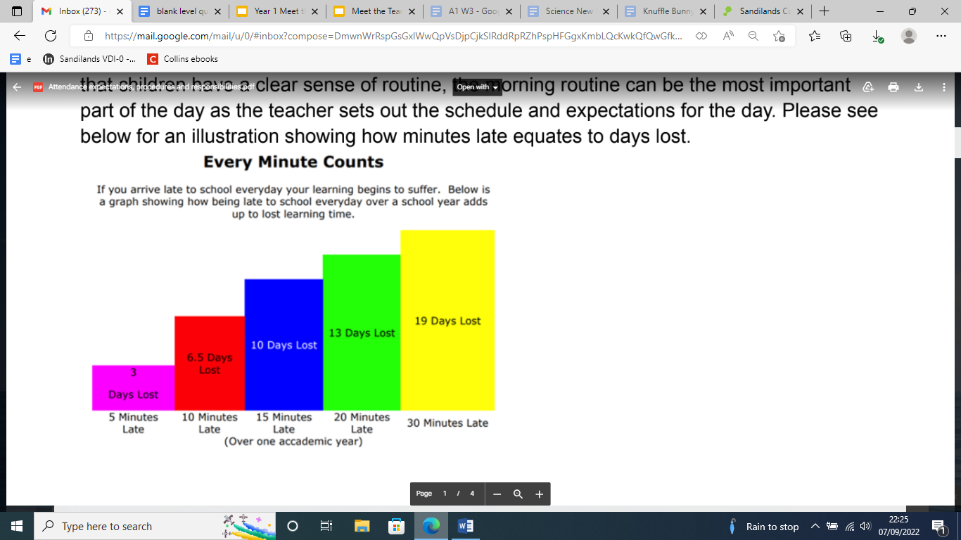
Attendance and punctuality…

Slide 8


Expectations – behaviour
Ready, respectful, safe
Traffic light system

Slide 9
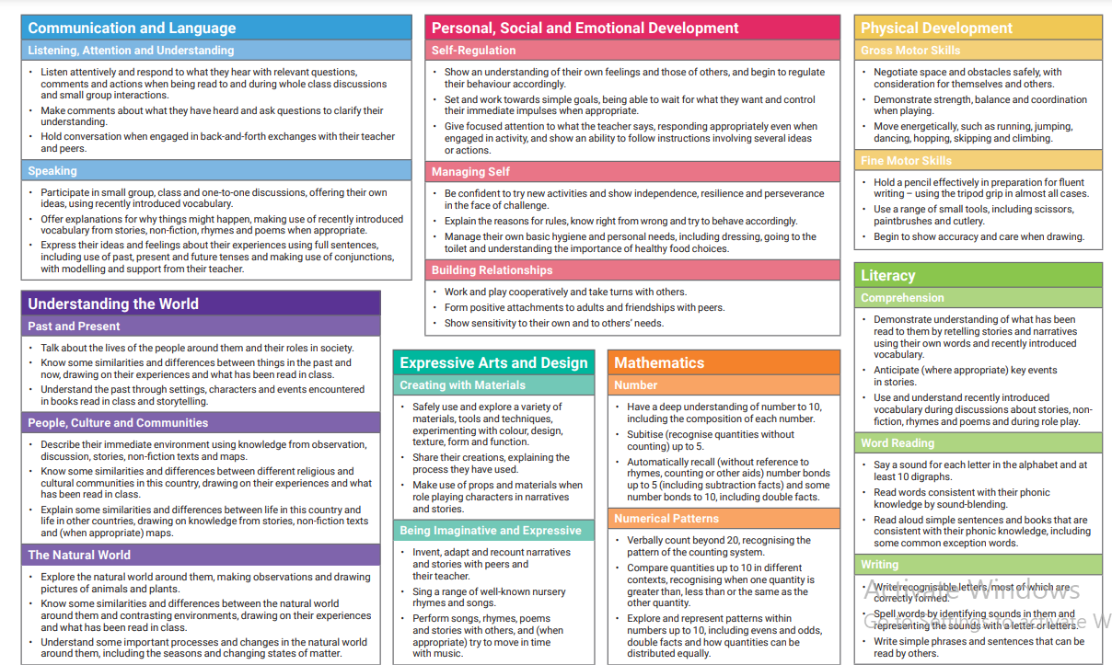
Early Years Curriculum
We are working towards achieving the Early Learning Goals in all
7 areas of the Early Years Curriculum;
Communication & Language
Personal, social, emotional development
Physical development
Literacy
Maths
Understanding the World
Expressive Arts & Design
The first 7 ELGs form the
‘Good Level of Development’
for Reception Children

Slide 10

Early Years Curriculum
Phonics
- Little Wandle – Parent’s meeting
Coming soon
Maths
- NCETM Mastering Number
Master the Curriculum
What are we learning each half term?
Please see curriculum leaflets for each class.

Slide 11



Slide 12
Early Years Curriculum
Teaching
Targeted group times throughout the day to help us meet the curriculum expectations
Continuous Provision
Indoor and Outdoor learning environments
Carefully planned resources and opportunities to continue the learning in the ‘absence of an adult’
Enhancements
Can be linked to topics, children’s interests or gaps in learning.

Slide 13
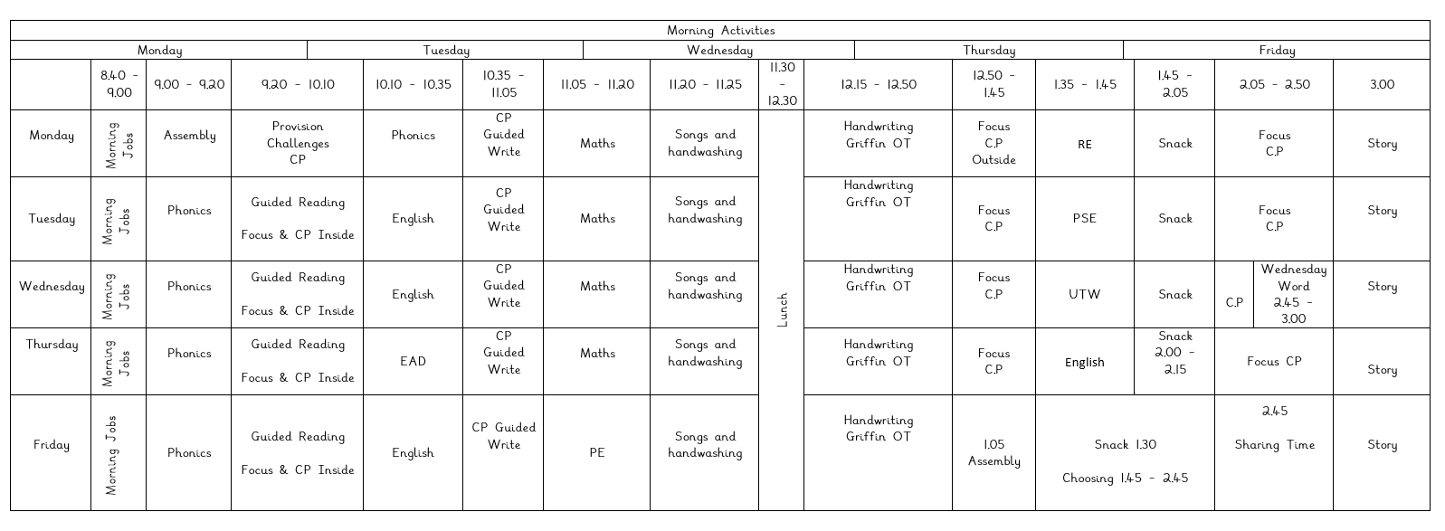
Reception - What does our day look like?

Slide 14
Expectations – what to wear/bring?
Children to arrive at school on time each day
8.40am – 3.20pm
Children to come to school in correct school uniform.
Sensible, black school shoes, please no trainers
Small stud earrings
Children to have their school bag every day.
Wellies or a puddle suit
Spare Uniform: Please pack spare underwear and uniform in your child's school bag.
NAME IT OR RISK LOSING IT!
We will always endeavor to find lost items but this is much simpler if items are named.

Slide 15
Reception Baseline Assessment
Statutory government assessment for Reception aged pupils
provides the starting point for a progress measure that will help parents understand how well schools support their pupils to progress between reception and year 6.
Short, interactive, practical assessment of your child’s early literacy, communication, language and mathematics skills
Please see handouts.

Slide 16
How can you support your child’s learning?
Reception
Read with your child every day and sign their reading record. Children will bring home their phonics book and a reading for pleasure book
Homework will be handed out each Friday and should be returned to school each Wednesday - Support children to look over phonics review sheets -
Independence – Help your child to practise self-help skills – zipping up coats, putting on and taking off shoes, removing uniform and putting on PE kit.
Keep an eye on ‘instagram’ and Seesaw for photographs to show you what we have been learning

Slide 17
Finally – a big ‘Thank You’!
Thank you for making a positive start to the year and for adapting to the changes that we are trying to implement around school.
With your support, we hope to make the EYFS years memorable and successful for all of our wonderful children!
Any questions?

