Slide 1


Year 3 September 2026

Slide 2
Staff Introductions
Miss Radcliffe will teach Monday, Tuesday, Wednesday and Thursday.
Mrs Stockdale will teach on Fridays.
Mrs Opara will be the classroom Teaching assistant.

Slide 3
How do we get information to/from the school?
Newsletters – these are sent out each Friday via text/email, uploaded to the school website and on to our instagram page.
Instagram - @stfrancismanchester
Emails and texts – please ensure your details are correct with the office
Website – stfrancismanchester.com
Call our office 0161 223 3457 or email admin@stfrancisrcps.co.uk

Slide 4
Expectations – what to wear/bring?
Correct school uniform – listed on the school website
Black shoes
Water bottle (only water allowed)
PE kit to be brought to school at the start of each half term and taken home at the end to be washed/shoes checked
Coat suitable for the weather
Reading book and record daily.
NAME IT OR RISK LOSING IT!
We will always endeavor to find lost items but this is much simpler if items are named.

Slide 5


Expectations – behaviour
Ready, respectful, safe
Traffic light system

Slide 6
Attendance and punctuality
Your child must be in school, on time, every day.
Gates open 8:40-8:50
If your child is too sick to attend school, you must call and inform the office before 9am.
Miss Deighan is responsible for attendance, and will work with you should you need support getting your child to school each day.

Slide 7
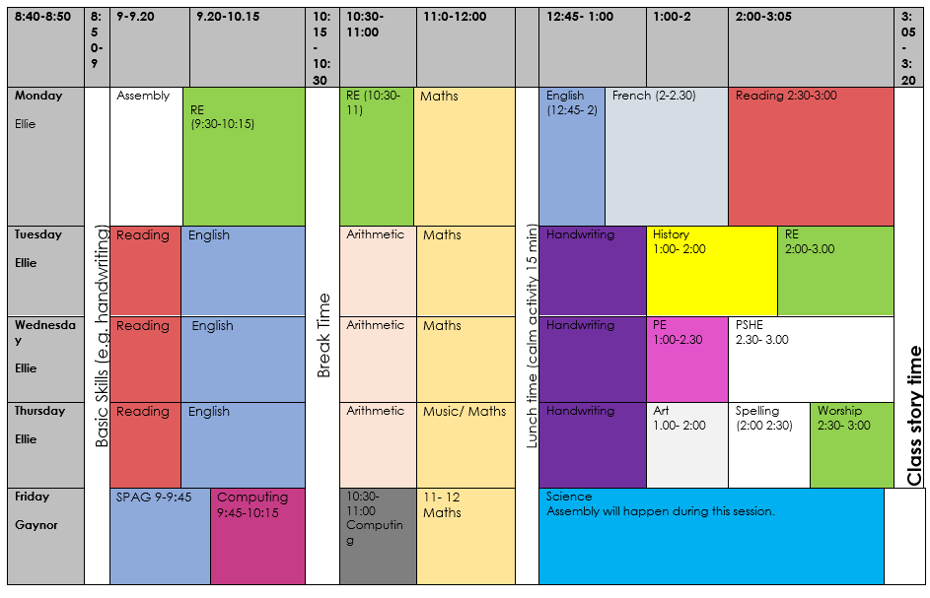
What does our day look like?

Slide 8
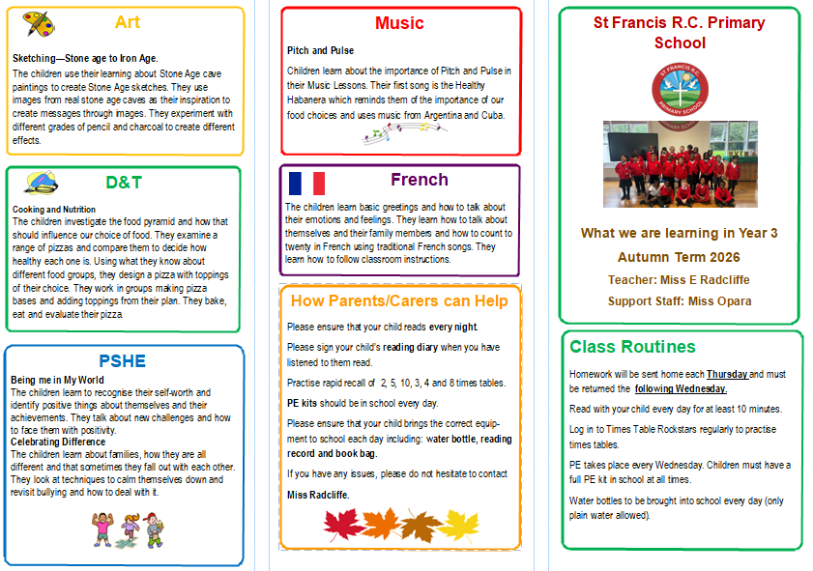
What does our curriculum look like?

Slide 9
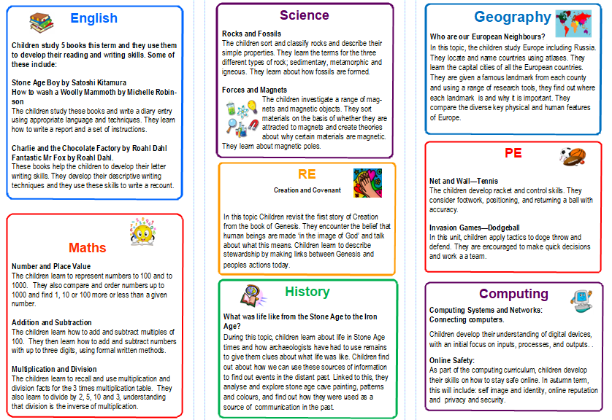
What does our curriculum look like?

Slide 10
How can you support your child’s learning?
Homework will be handed out each Friday and should be returned to school each Wednesday
Read with your child every day and sign their reading record
TT Rockstars

Slide 11
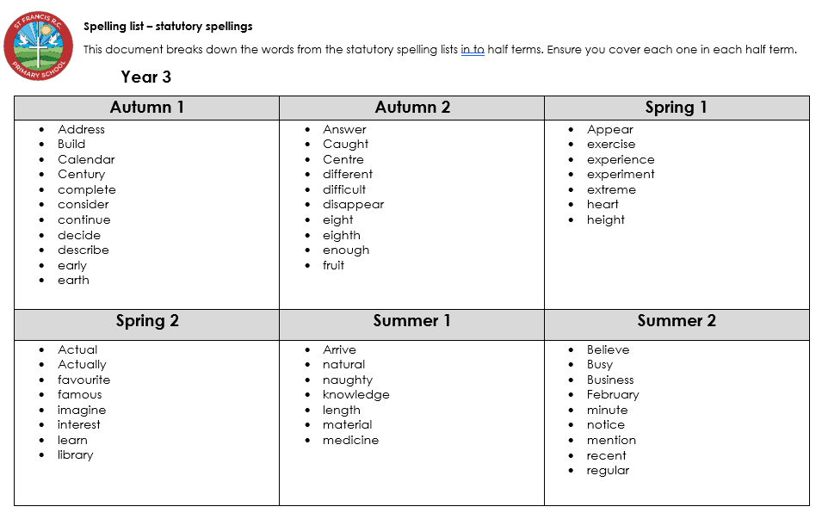
Spellings
We will not be having spelling tests this year in school, however you can still support your children with their spelling at home.

Slide 12
Information About the Sacramental Program
More information on this will follow from Father Kevin.

Slide 13
Finally – a big ‘Thank You’!
Thank you for making a positive start to the year, for choosing St Francis, and for supporting us to support your children to be the best that they can be!
With your support, we hope to make Year 3 memorable and successful for all of our wonderful children!
Any questions?

