Slide 1


Year 4 September 2026

Slide 2
Staff Introductions
Mrs Jagger-Smith (Miss Jagger)
Miss Richards
Miss Roberts – P.E
Madame O’Neill - French

Slide 3

FIRM
FAIR
FUN

Slide 4
How do we get information to/from the school?
Newsletters – these are sent out each Friday via text/email, uploaded to the school website and on to our Instagram page.
Emails and texts – please ensure your details are correct with the office
Website – stfrancismanchester.com
Call our office 0161 223 3457 or email admin@stfrancisrcps.co.uk

Slide 5
Expectations – what to wear/bring?
Correct school uniform – listed on the school website
Black shoes
Water bottle
PE kit to be brought to school at the start of each half term and taken home at the end to be washed
Coat suitable for the weather
Reading book and record daily
NAME IT OR RISK LOSING IT!
We will always endeavor to find lost items but this is much simpler if items are named.

Slide 6


Expectations – behaviour
Ready, respectful, safe
Traffic light system

Slide 7
Attendance and punctuality
Your child must be in school, on time, every day.
If your child is too sick to attend school, you must call and inform the office before 9am.
Miss Deighan is now responsible for attendance, and will work with you should you need support getting your child to school each day.

Slide 8
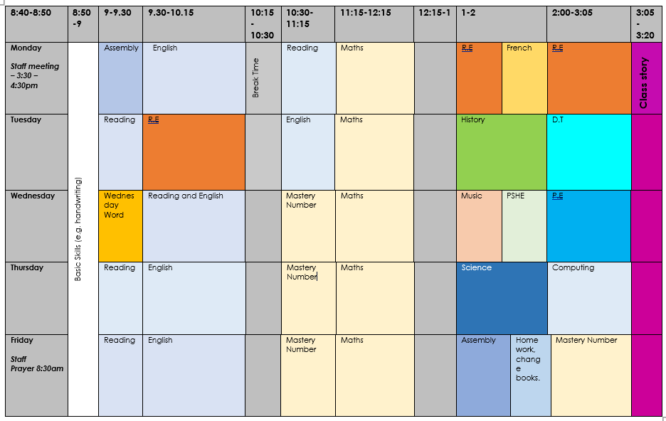
What does our day look like?

Slide 9
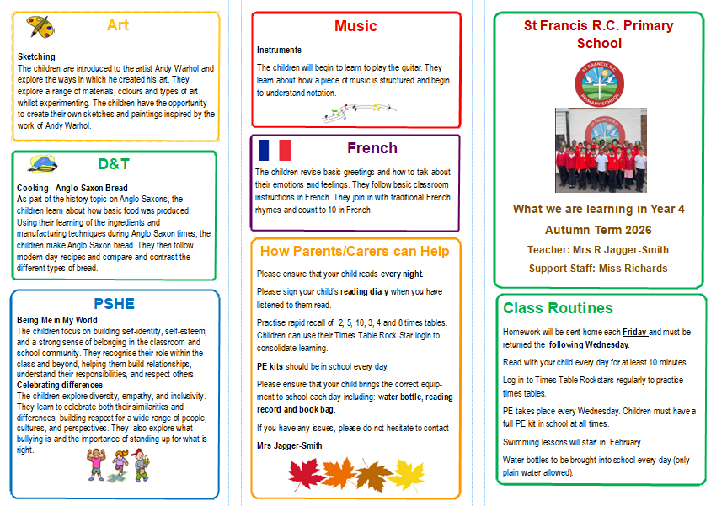
What does our curriculum look like?

Slide 10
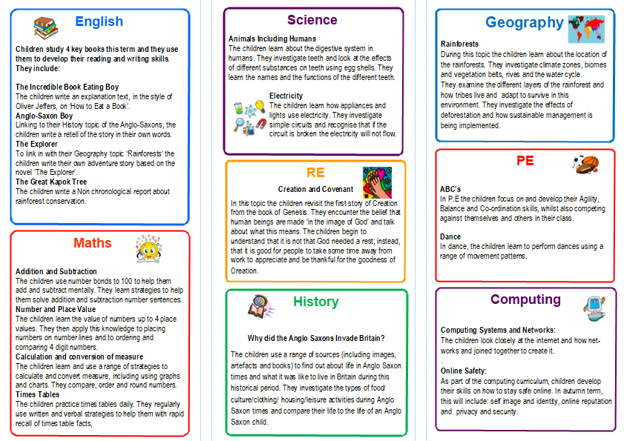
What does our curriculum look like?

Slide 11
How can you support your child’s learning?
Homework will be handed out each Friday and should be returned to school each Wednesday
Read with your child every day and sign their reading record
TT Rockstars
Spelling
Speech “ .” said Mrs O’Dwyer.

Slide 12
Key dates for year 4
Swimming starts in February 2026
Times table checker in June 2026

Slide 13
Finally – a big ‘Thank You’!
Thank you for making a positive start to the year and for adapting to the changes that we are trying to implement around school
With your support, we hope to make Year 4 memorable and successful for all of our wonderful children!
Any questions?

