Slide 1


Year 1 Welcome Meeting
16th September 2026

Slide 2
Staff Introductions
Miss Bowcock will be Year 1’s class teacher.
Miss Broderick will in in class when Miss Bowcock is on planning time.

Slide 3



Slide 4
How do we get information to/from the school?
Newsletters – these are sent out each Friday via text/email, uploaded to the school website.
Instagram - @stfrancismanchester
Emails and texts – please ensure your details are correct with the office
Website – stfrancismanchester.com
Call our office or email admin@stfrancisrcps.co.uk

Slide 5
Expectations – what to wear/bring?
Correct school uniform – listed on the school website
Black shoes.
Water bottle – plain tap water please.
PE kit to be brought to school at the start of each half term and taken home at the end to be washed
Coat suitable for the weather
Reading book and record – everyday please!
NAME IT OR RISK LOSING IT!
We will always endeavor to find lost items, but this is much simpler if items are named.

Slide 6


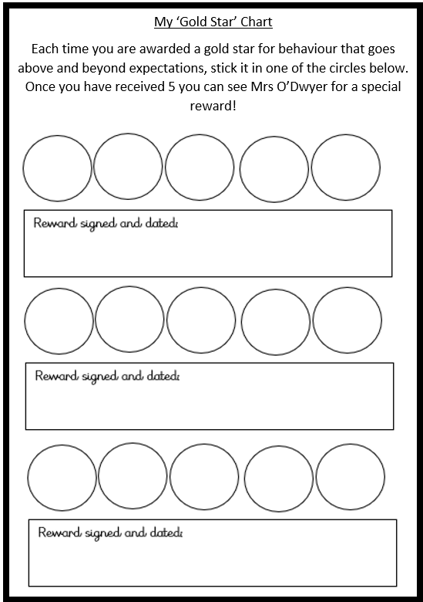
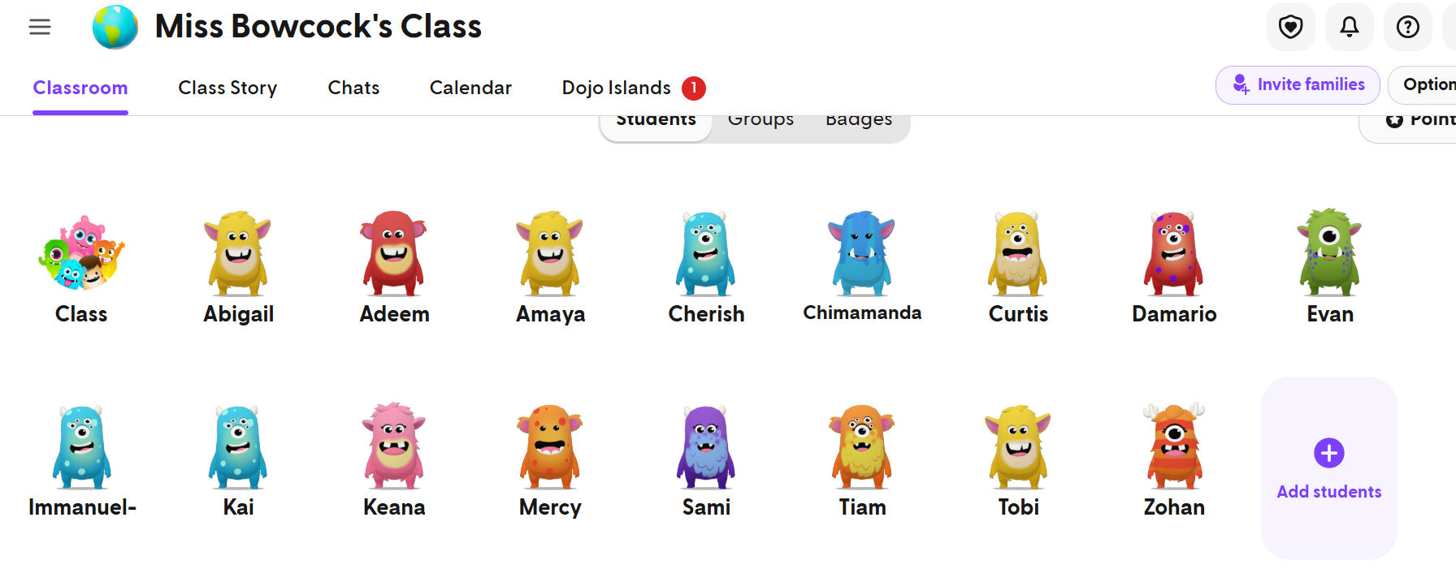
Expectations – behaviour
Ready, respectful, safe
Traffic light system

Slide 7
Attendance and punctuality
Your child must be in school, on time, every day.
If your child is too sick to attend school, you must call and inform the office before 9am.
Miss Deighan is responsible for attendance and will work with you should you need support getting your child to school each day.

Slide 8
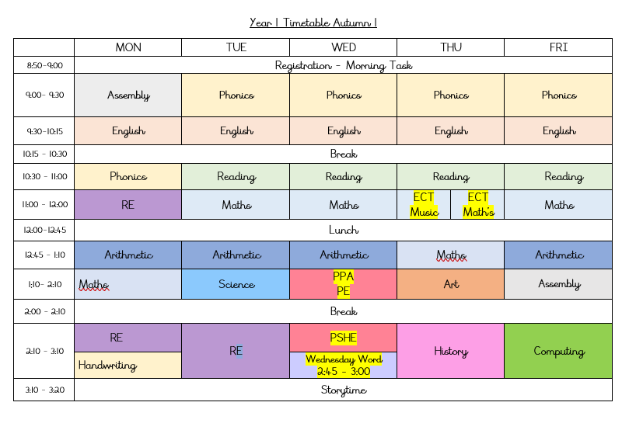
What does our day look like?
Year 1 Timetable Autumn 1

Slide 9


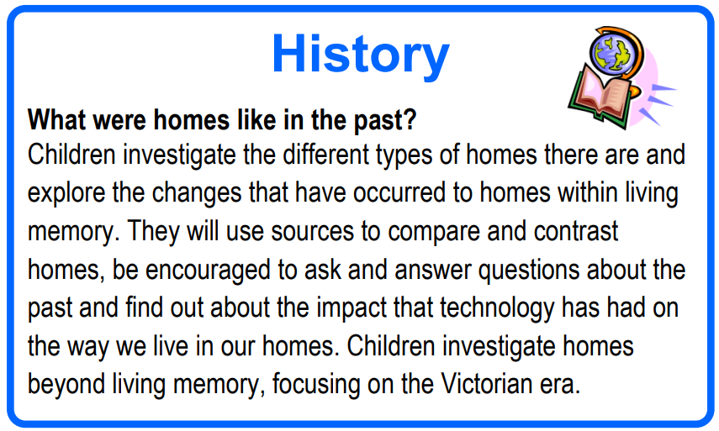
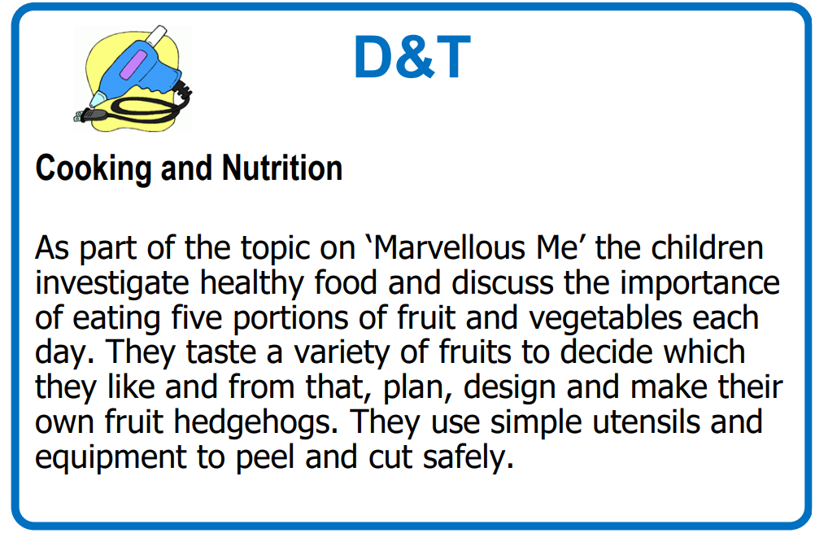
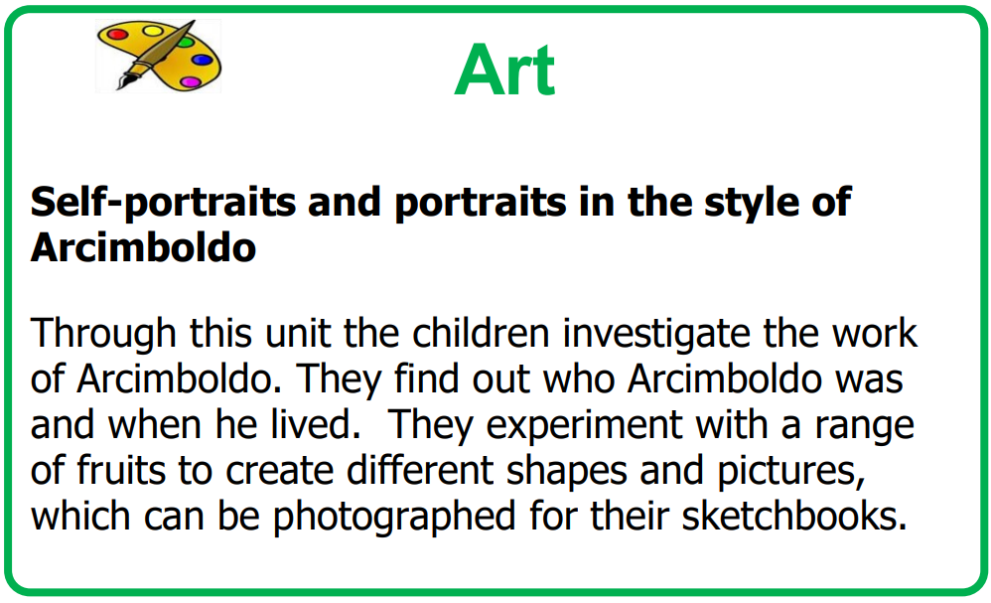
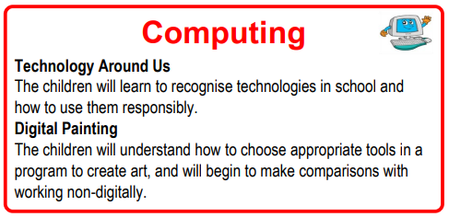
What does our curriculum look like?
Geography
Our Home—Gorton
During this unit of work, children will build on their understanding of the United Kingdom before focusing on their immediate locality of Gorton. They will investigate local amenities and explain why Gorton is a good place to live. Children will use directional language to locate key features of the area. Ultimately, they will create a booklet using photographs from fieldwork, explaining the key human and physical features of the area.
Science
Animals Including humans
During this topic, children name the parts of the human body. They learn about the senses and which part of the body is associated with each sense. They carry out investigations linked to the senses. They then go on to classify different types of animals.

Slide 10
How can you support your child’s learning?
Homework will be handed out each Friday and should be returned to school each Wednesday.
Read with your child every day and sign their reading record
Spelling

Slide 11
Key dates for Year 1
Phonics Screen Check – WC Monday 14th June 2027.

Slide 12
Finally – a big ‘Thank You’!
Thank you for making a positive start to the year and for continuing to support your child.
With your support, we hope to make Year 1 memorable and successful for all of our wonderful children!
Any questions?

